Slide 1

Heli-rescue and relief operations
in post-disaster management
Uttarakhand State Disaster Management Authority
USDMA

Slide 2
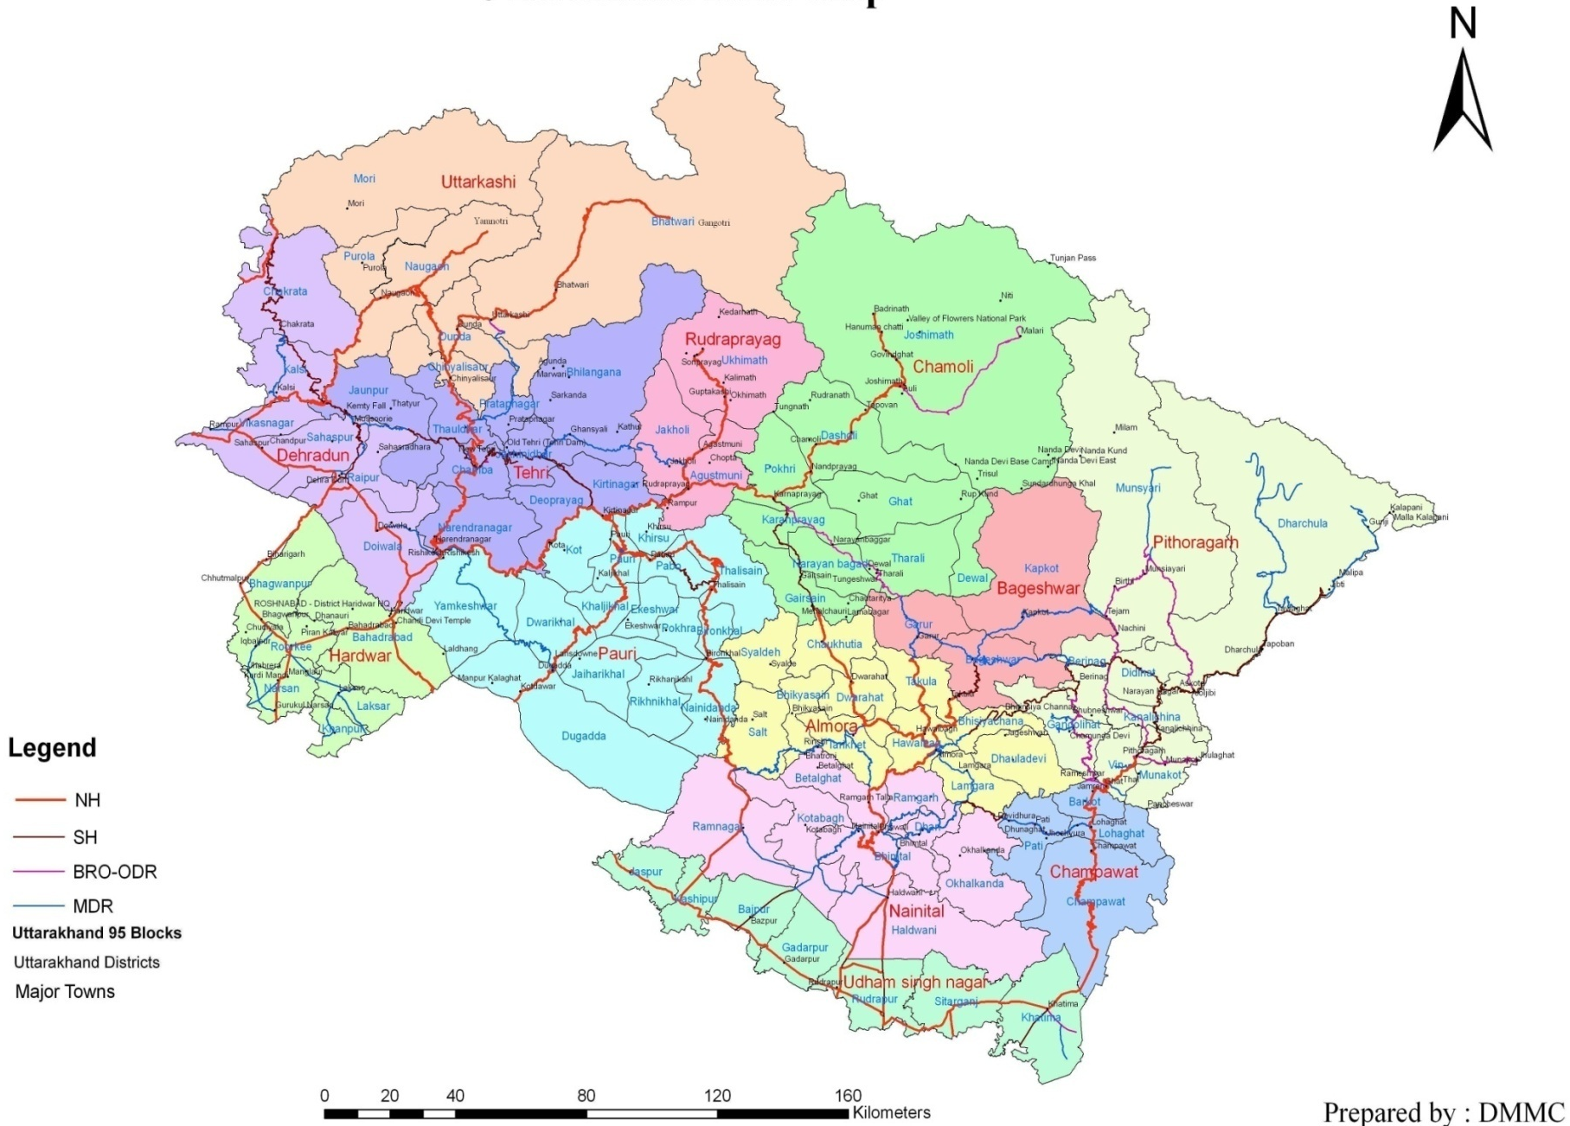
Uttarakhand

Slide 3
Highly vulnerable to natural hazards
Earthquakes and landslides
Cloud burst
Flash floods
Forest fires

Slide 4
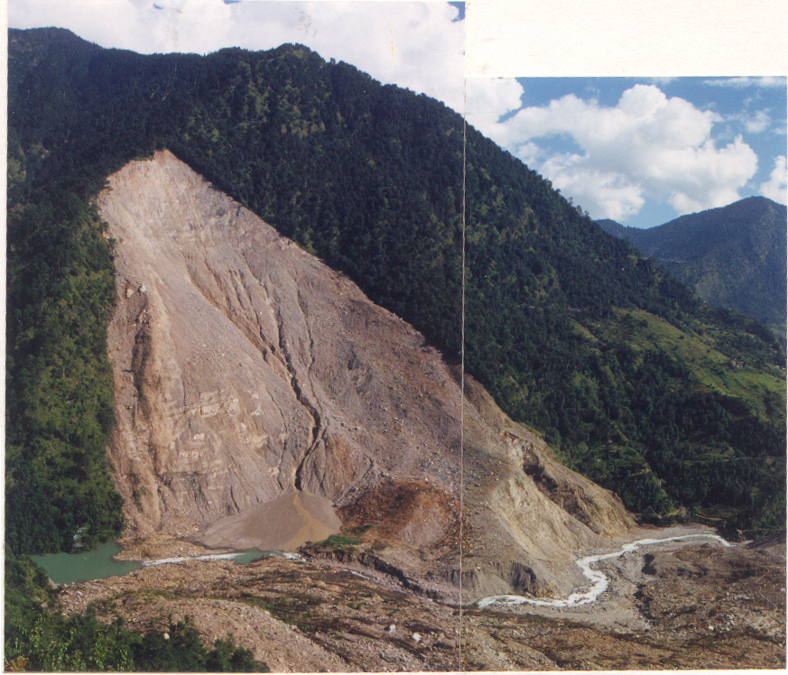
Ookhimath Landslide, 1998
Casualties > 100

Slide 5
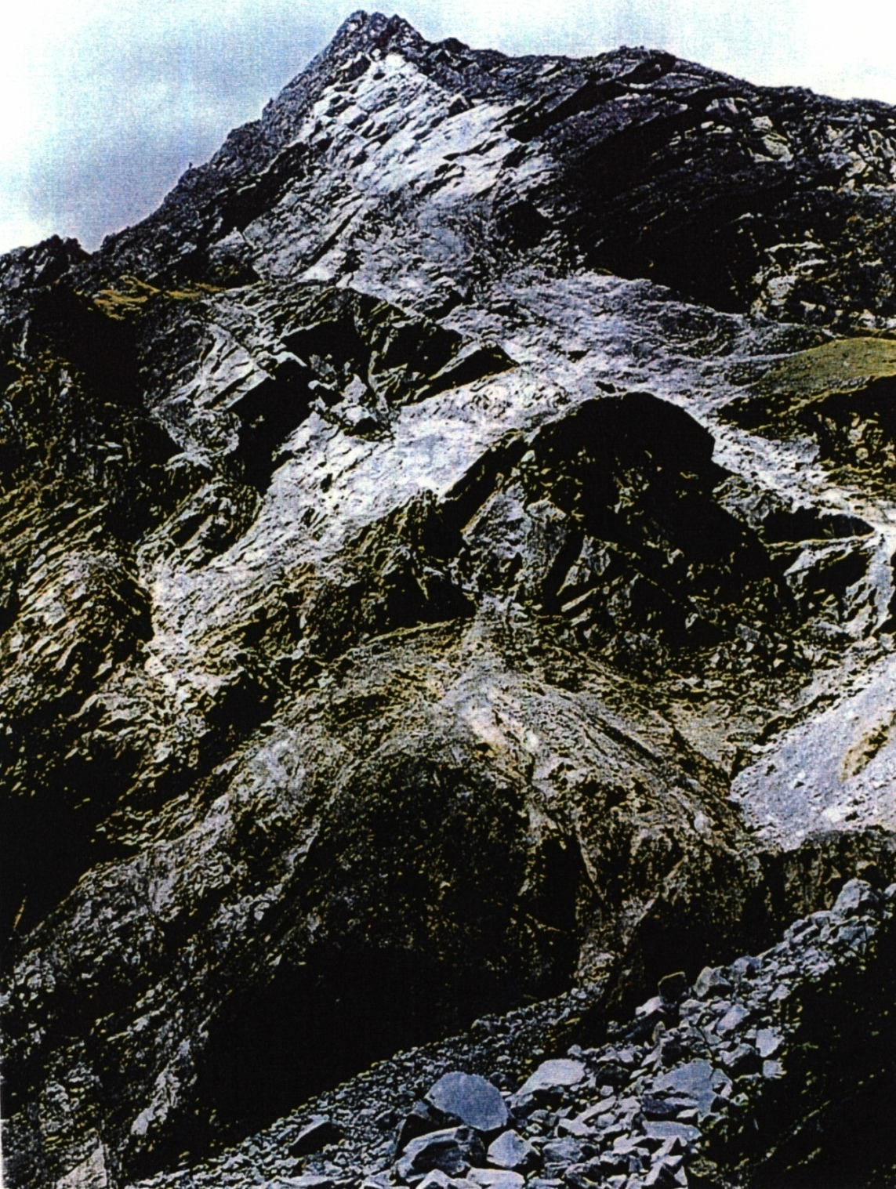
Malpa Landslide,1998
(Rock fall)
Casualties > 250

Slide 6
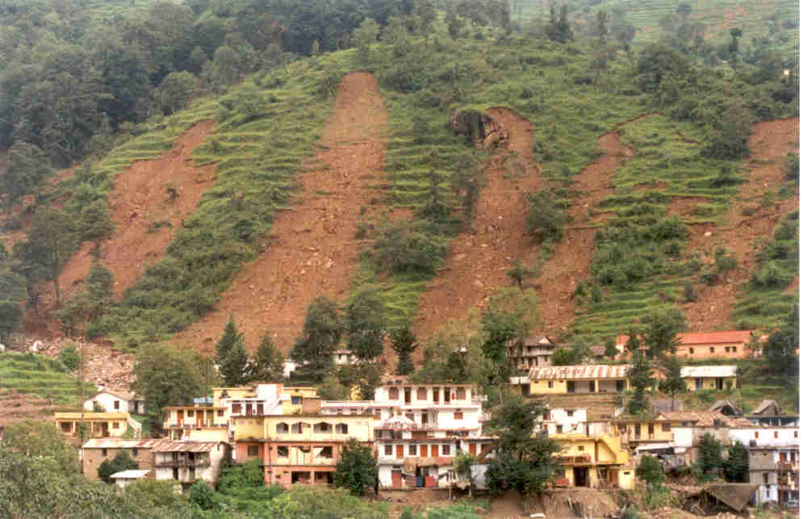
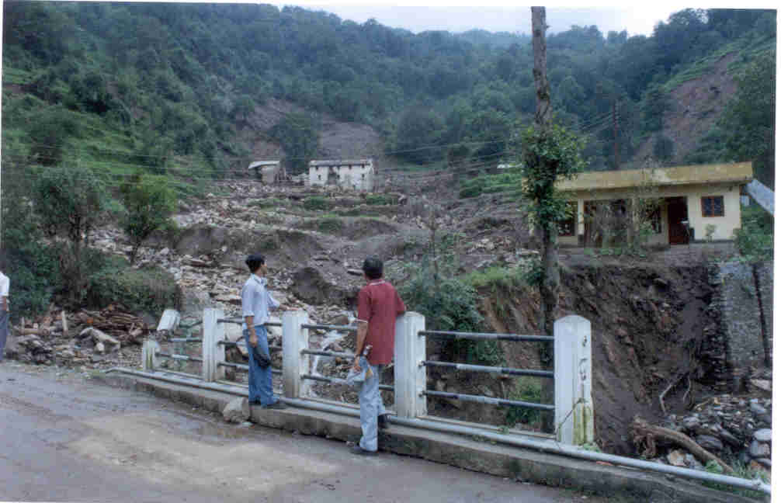
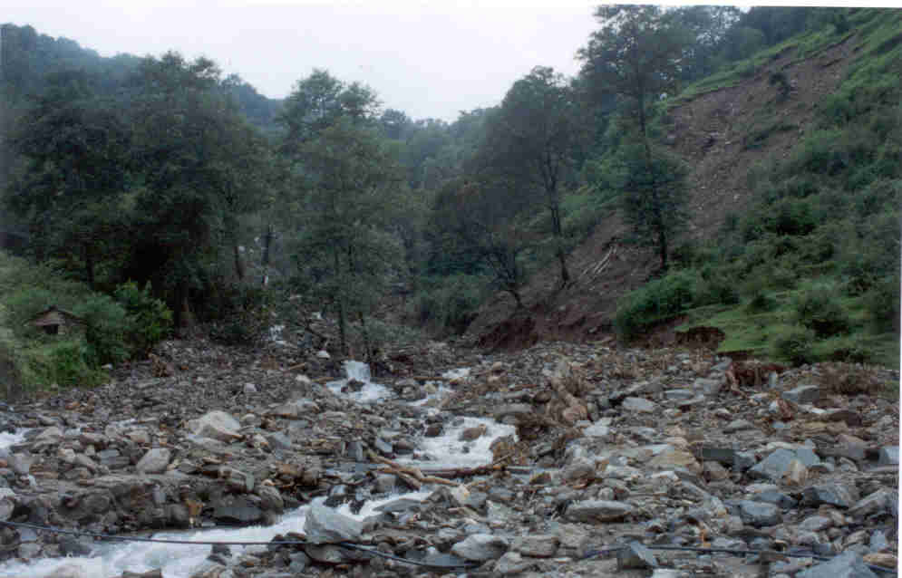
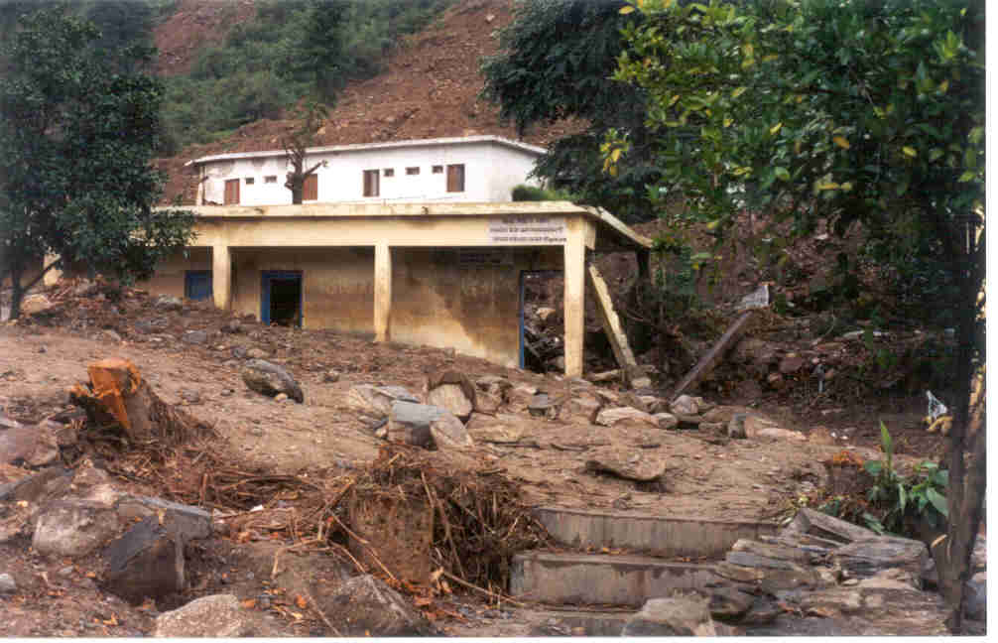
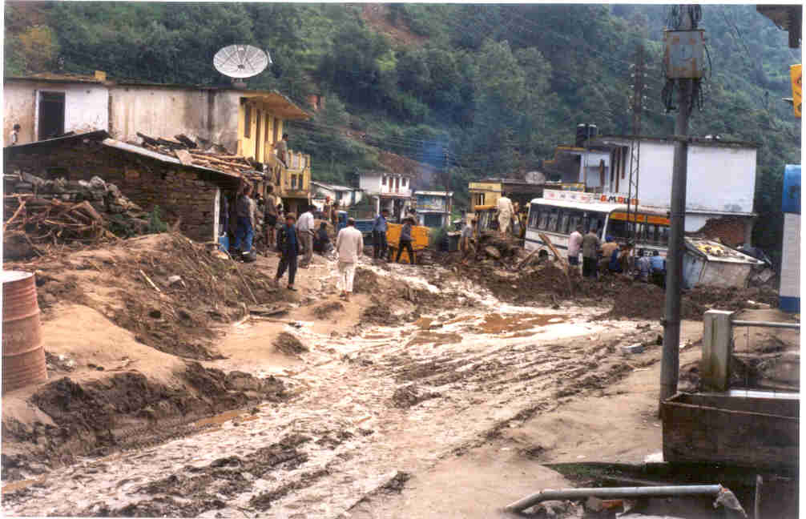
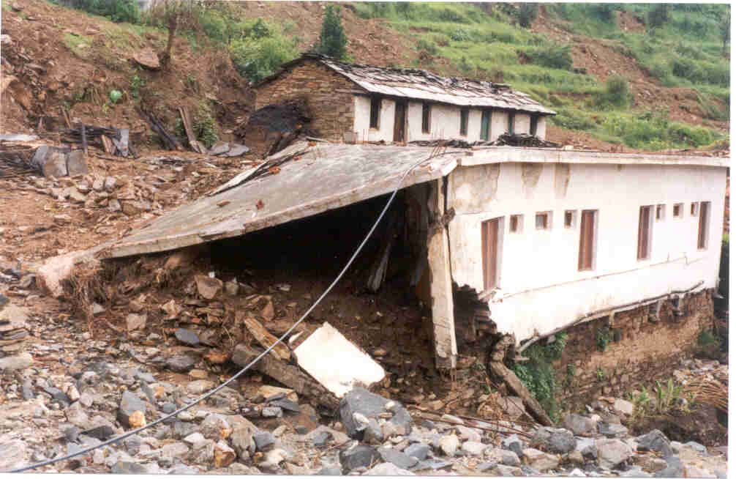
Phata Landslide,16th July, 2001
Casualties - 15 persons

Slide 7
Kedarnath tragedy of June, 2013

Slide 8
Mandakini was 7.5 meters above danger level in Rudraprayag on 17th June, 2013
Date | Rainfall (in mm) |  | Level of Mandakini at Rudraprayag (mts asl) against danger level of 626 m asl
 | Rudraprayag | Gaurikund
15 June | 41.4 | 250.0 | 618.12
16 June | 105.2 | + 250.0 | 625.00
17 June | 100.2 | 180.0 | 633.50
18 June | 62.1 | 0.0 | 626.65
19 June | 7.0 | 0.0 | 623.00
20 June | 0.0 | 0.0 | 622.48

Slide 9
Almost all the roads were blocked
More than 1.5 lakh persons were stranded
There were widespread losses across the state
05 districts were worst affected; Pithoragarh, Bageshwar, Chamoli, Uttarkashi and Rudraprayag

Slide 10
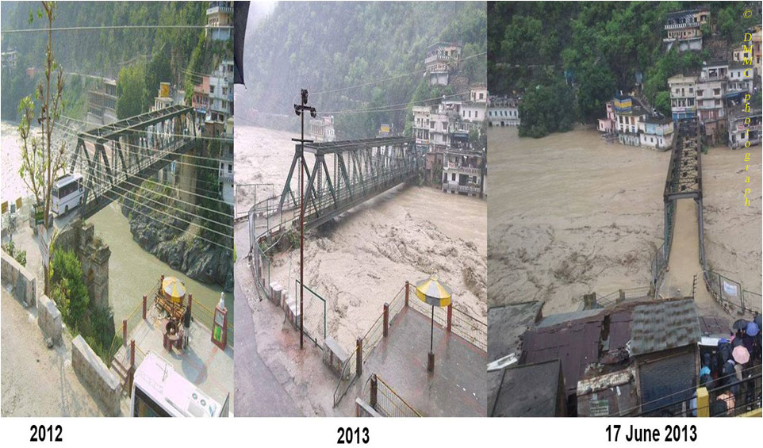
Alaknanda in Rudraprayag
2012
16 June, 2013
17 June, 2013

Slide 11
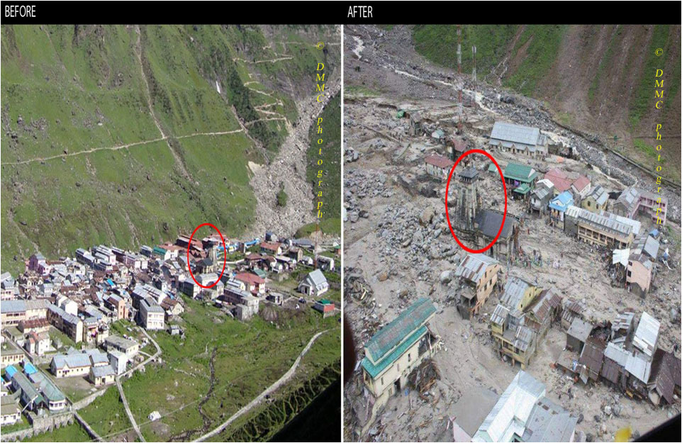
Kedarnath
Before
After

Slide 12
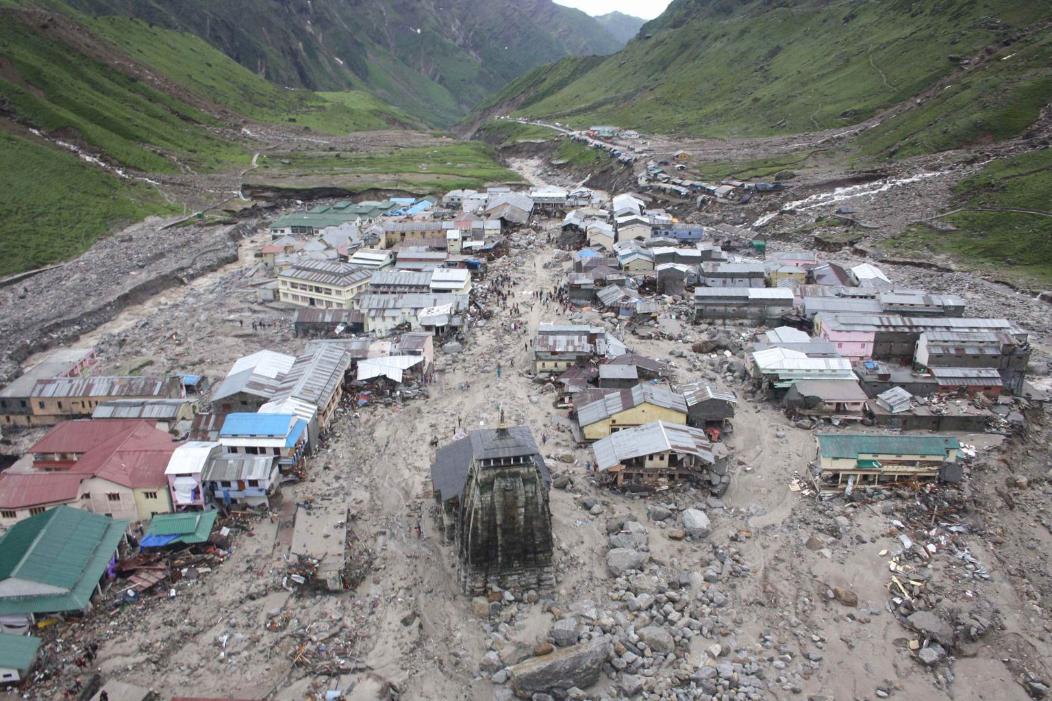
Damage in Kedarnath

Slide 13
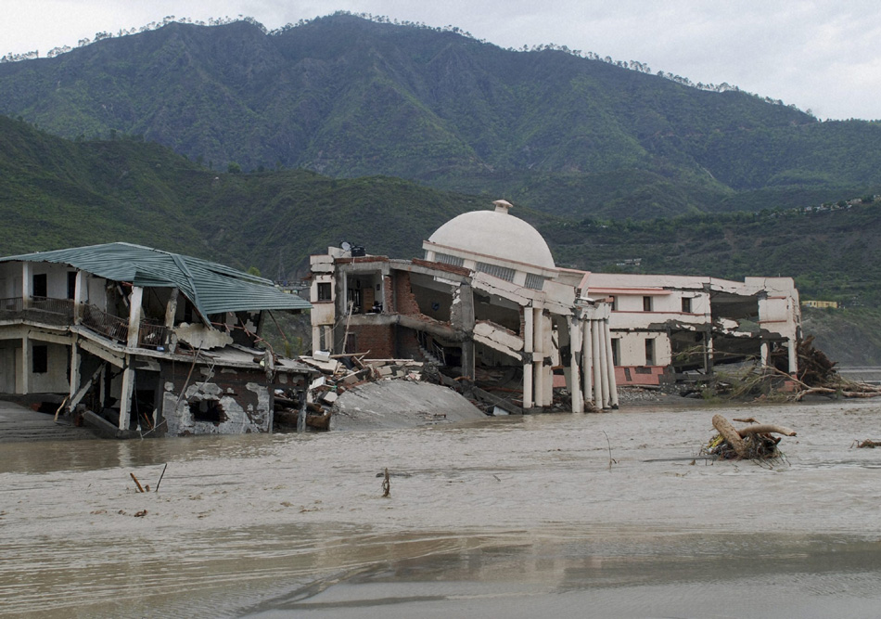
Damage to SSB Academy at Srinagar by Alaknanda

Slide 14
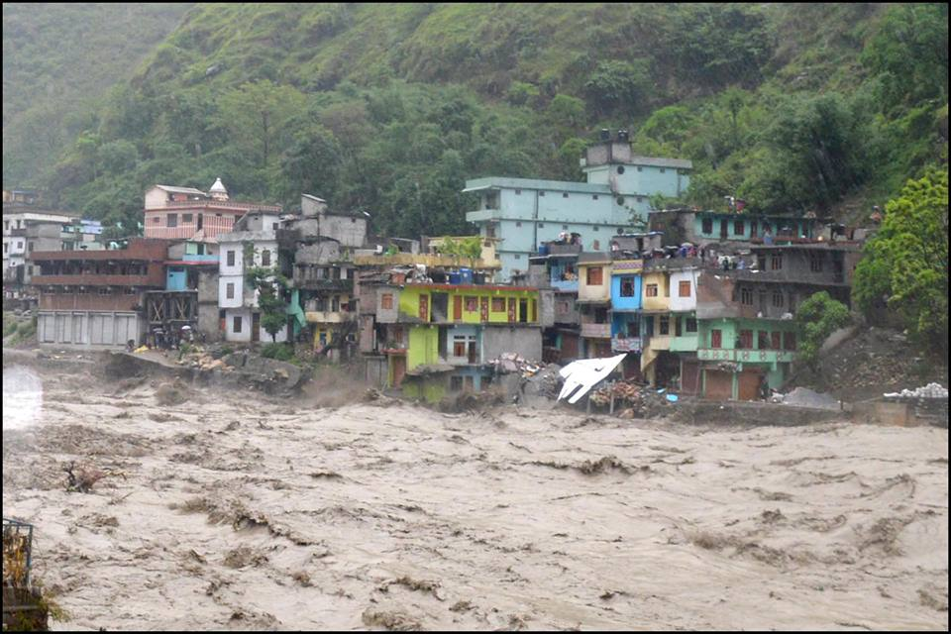
Devastation by Kali river at Dharchula

Slide 15
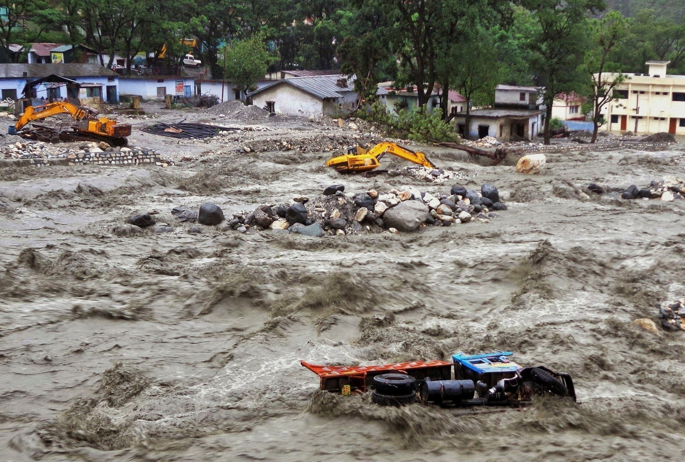
Devastation by Asiganga in Rudraprayag

Slide 16
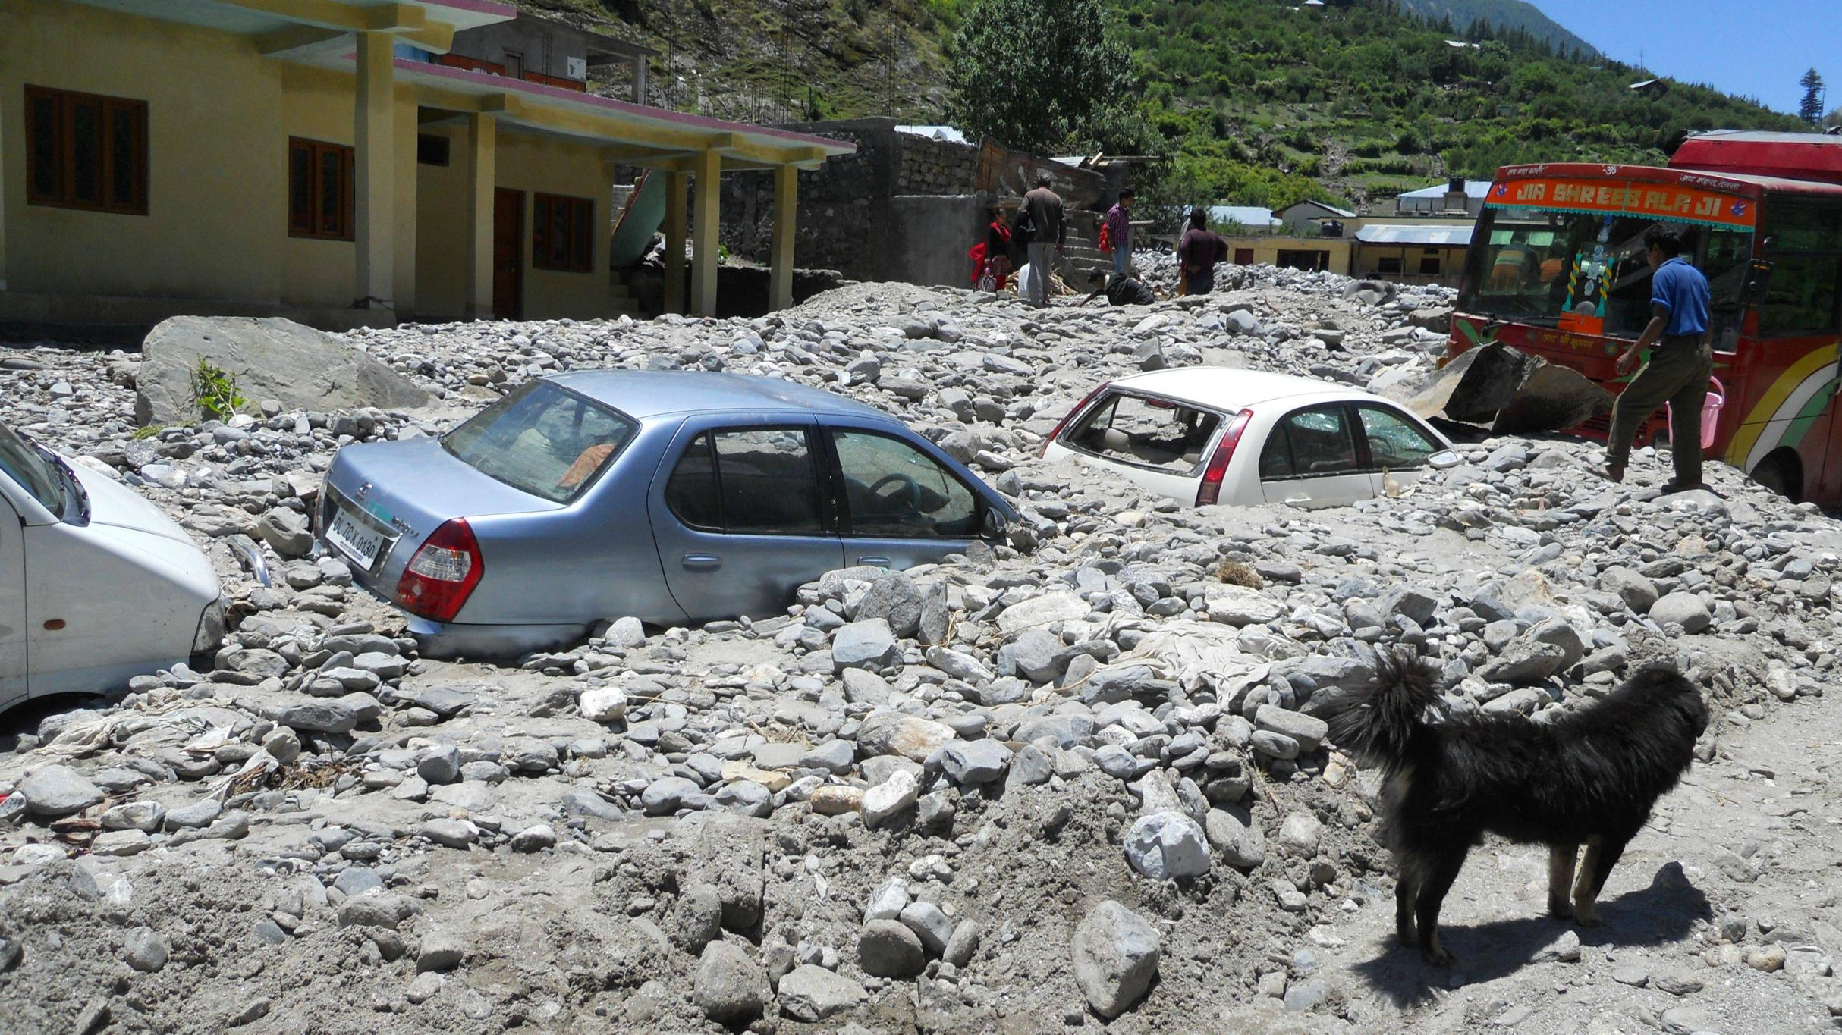
Vehicles buried in debris in Uttarkashi

Slide 17
Relief and rescue operations
Besides 17 civilian choppers hired by State Government, 54 IAF choppers and fixed wing crafts, 07 Army Aviation choppers and 04 choppers of other states were pressed into operation
69 permanent and temporary helipads were activated to evacuate stranded people

Slide 18
The Air force undertook more than 3000 sorties putting in approximately 1,250 hours.
More than 39,165 people were evacuated by air and more than 650 tonnes of relief material was dropped in the affected areas

Slide 19
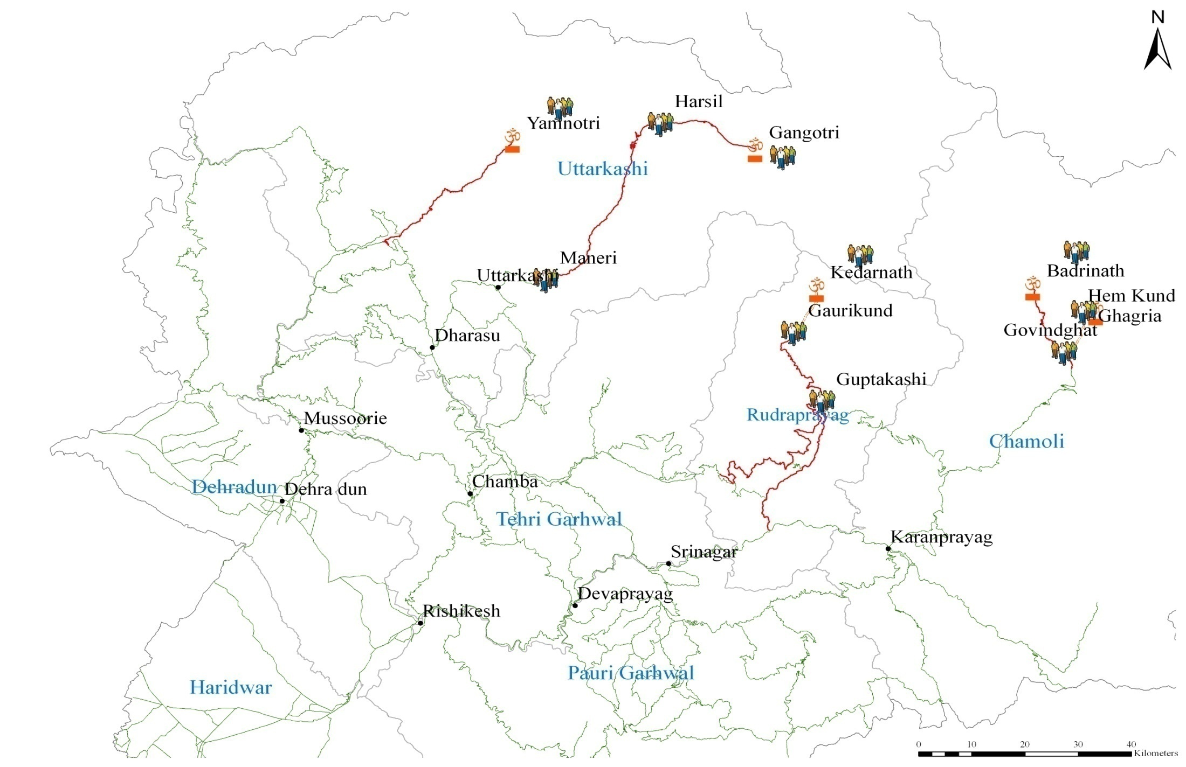
Pilgrims and locals were stranded at a number of places as all the roads were blocked

Slide 20
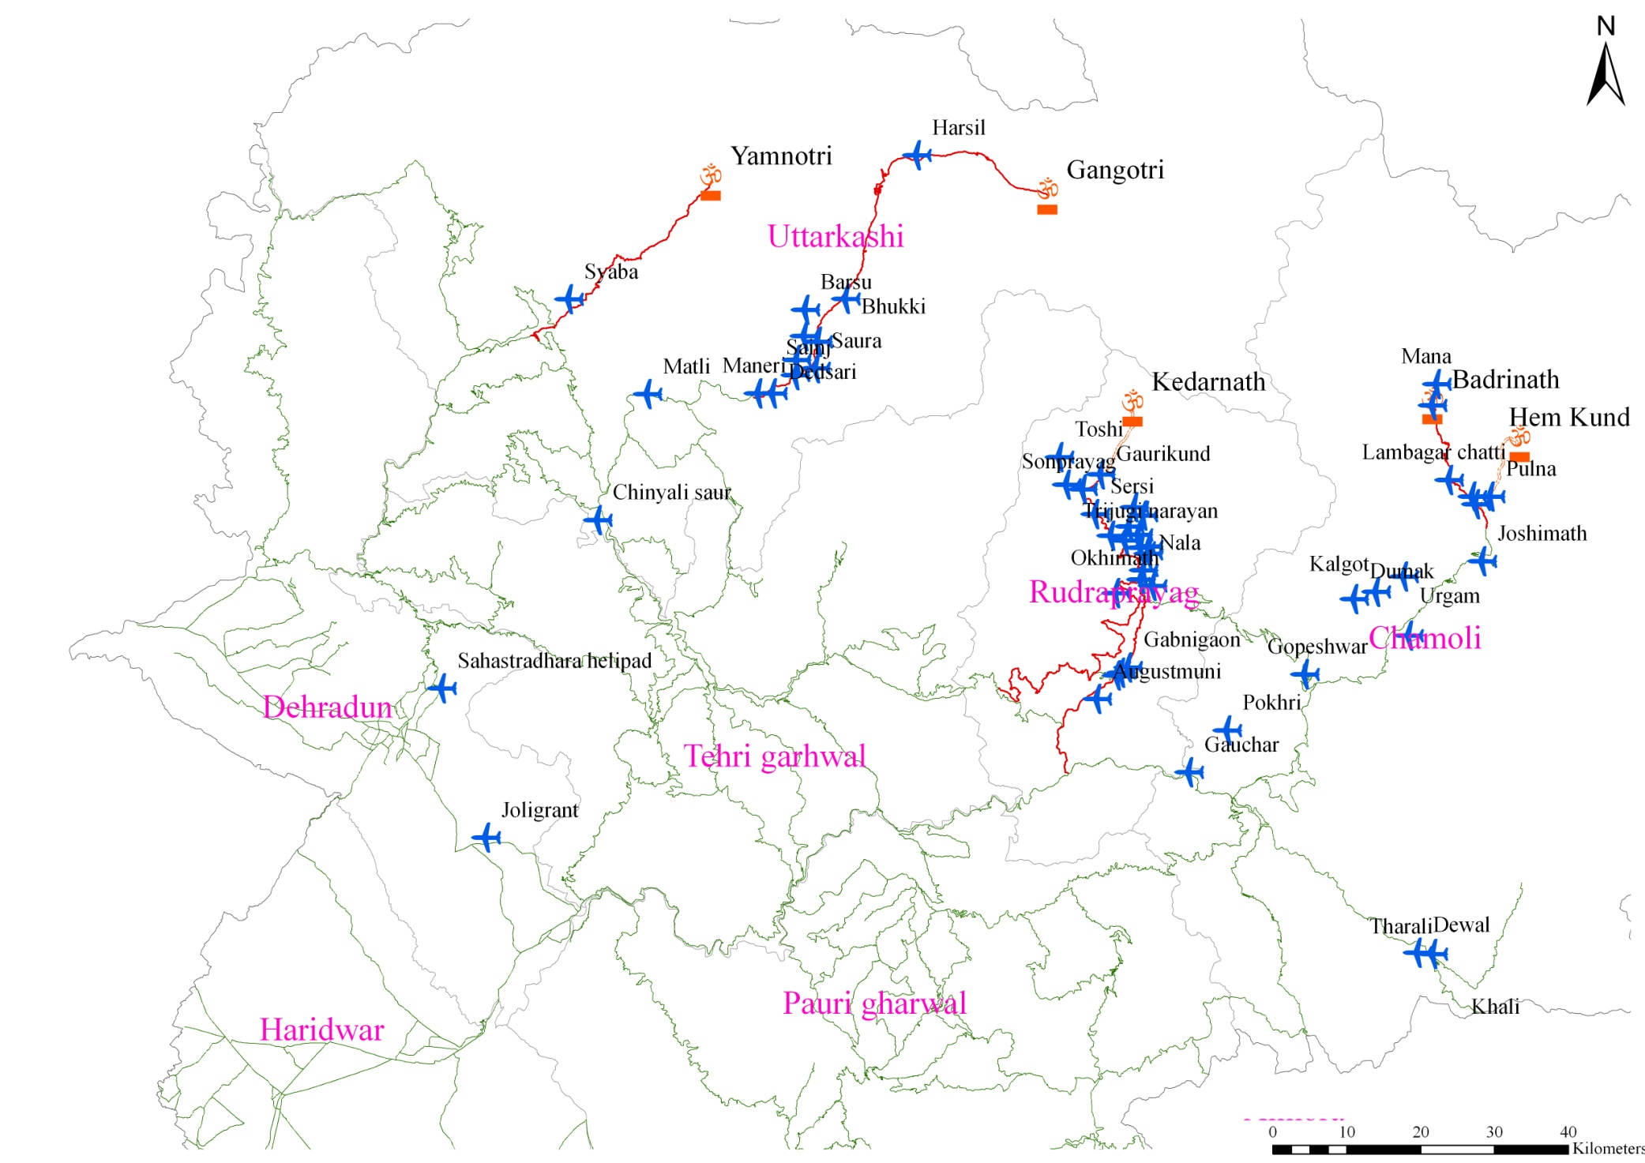
Helipads operationalised for rescue and relief

Slide 21
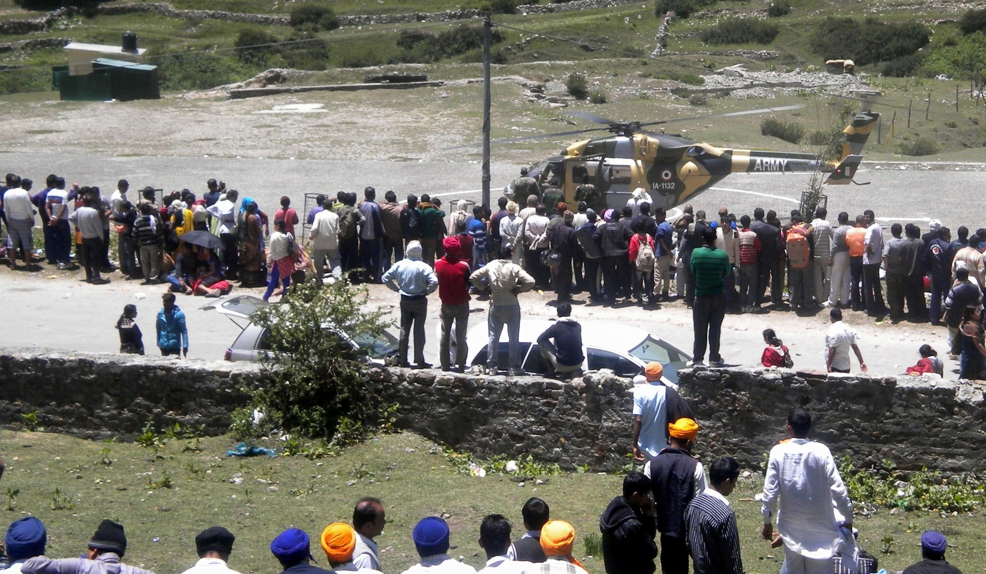
Heli-rescue in Kedarnath

Slide 22
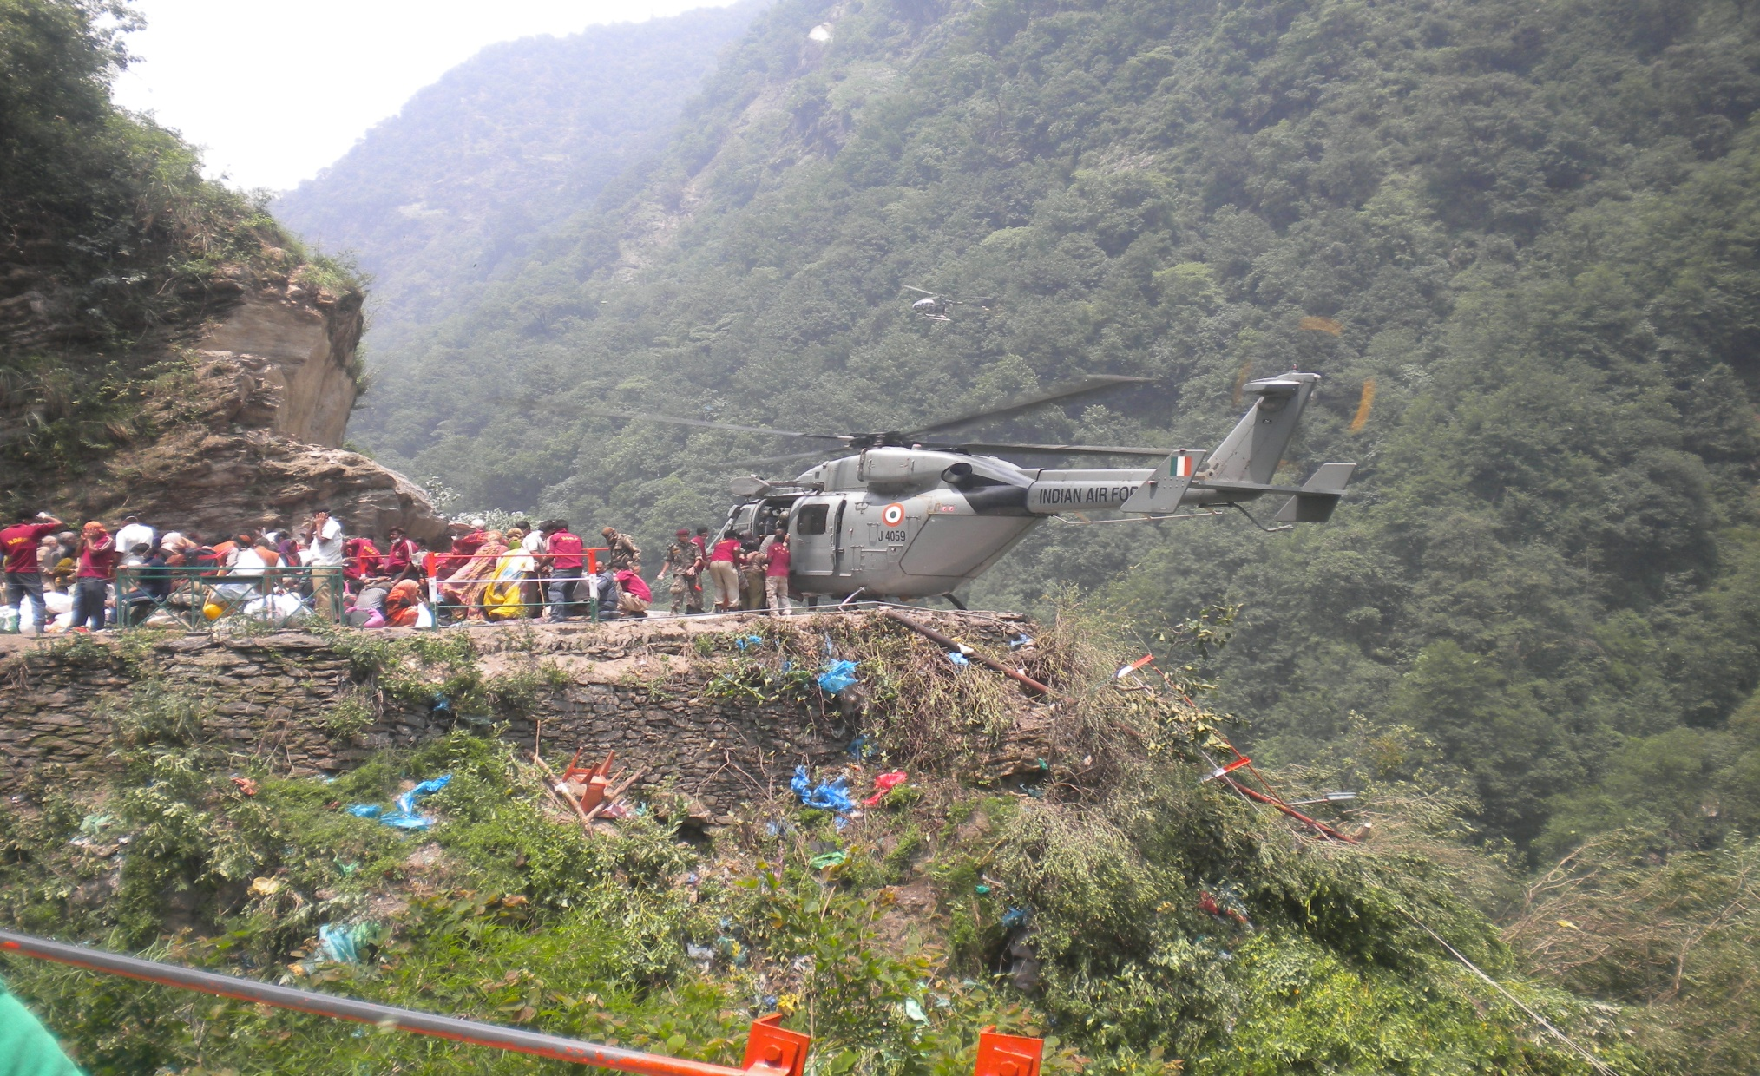
Heli-Rescue in Chamoli

Slide 23
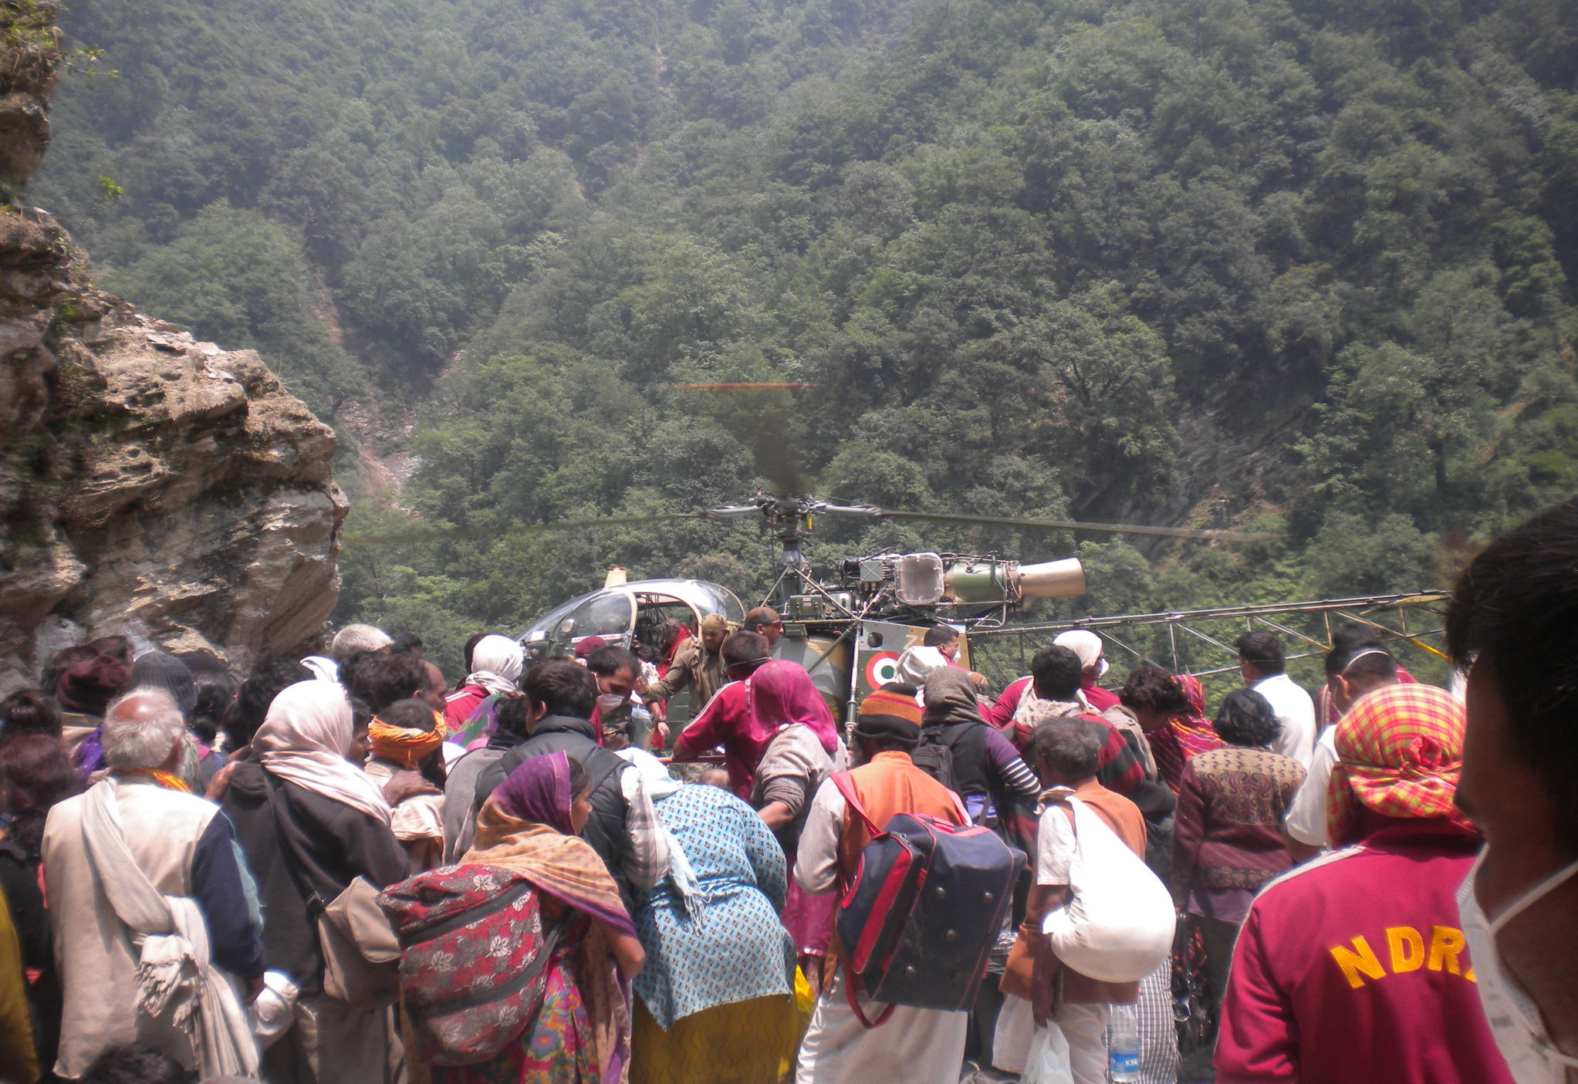
Heli-Rescue in Rudraprayag

Slide 24
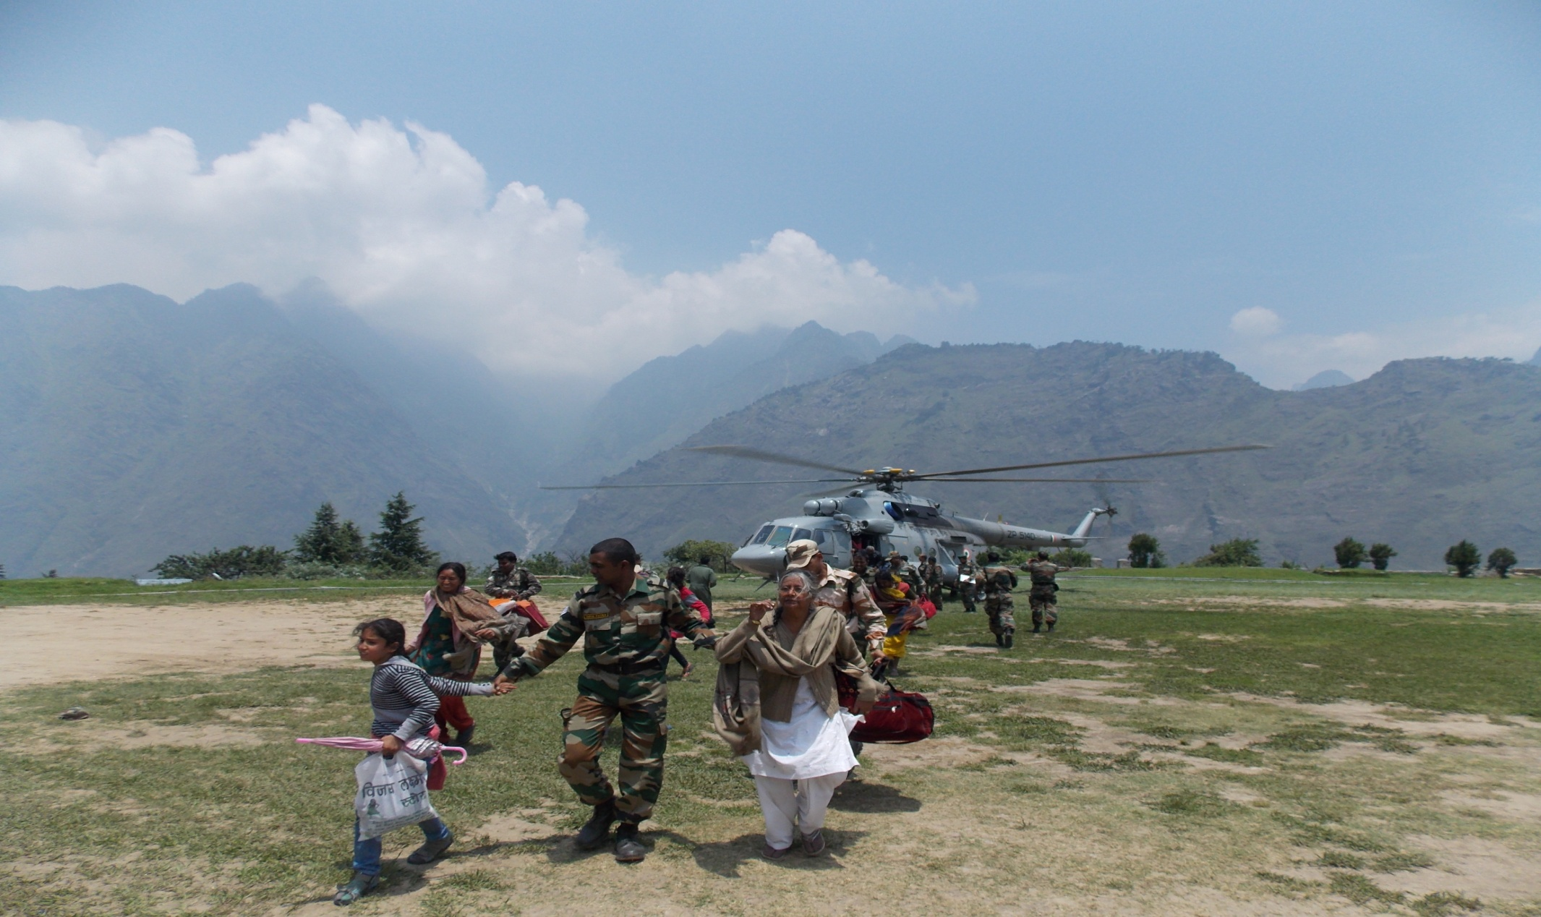
Rescue Operations – Joshimath Helipad

Slide 25
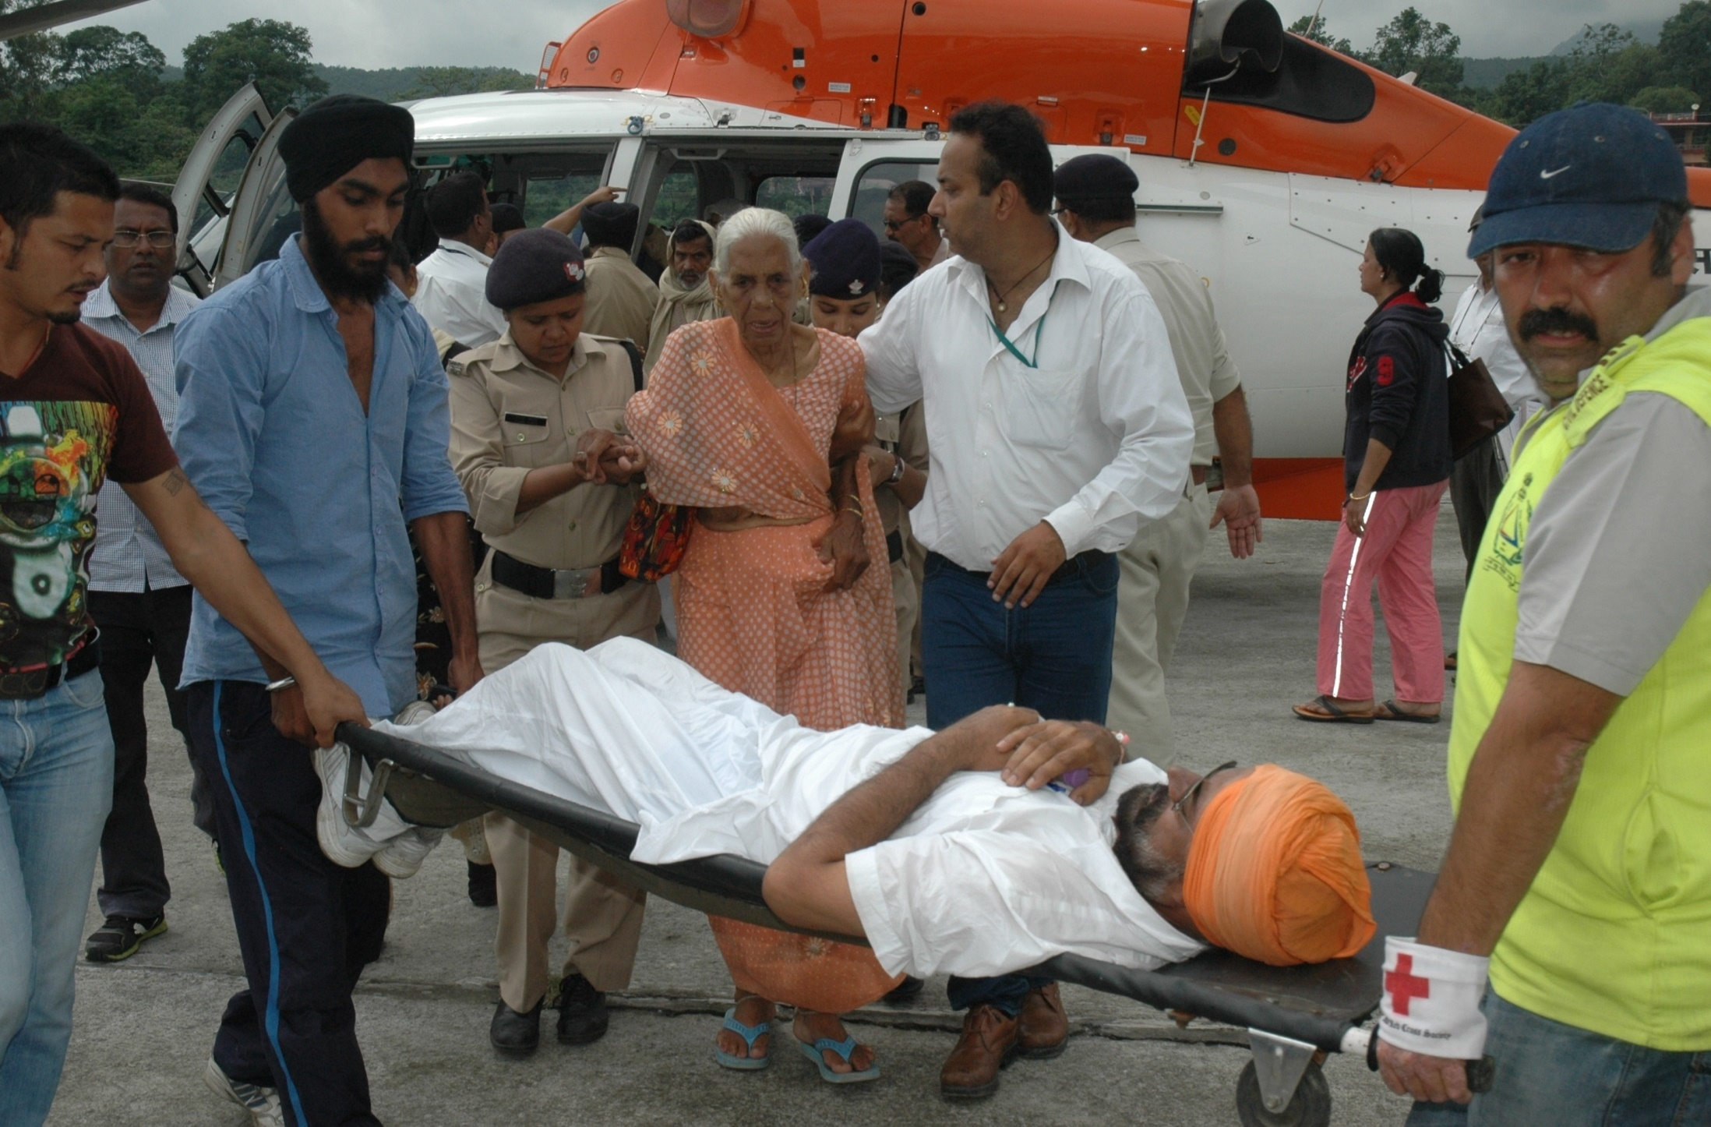
Rescue Operations – Alaknanda Valley

Slide 26
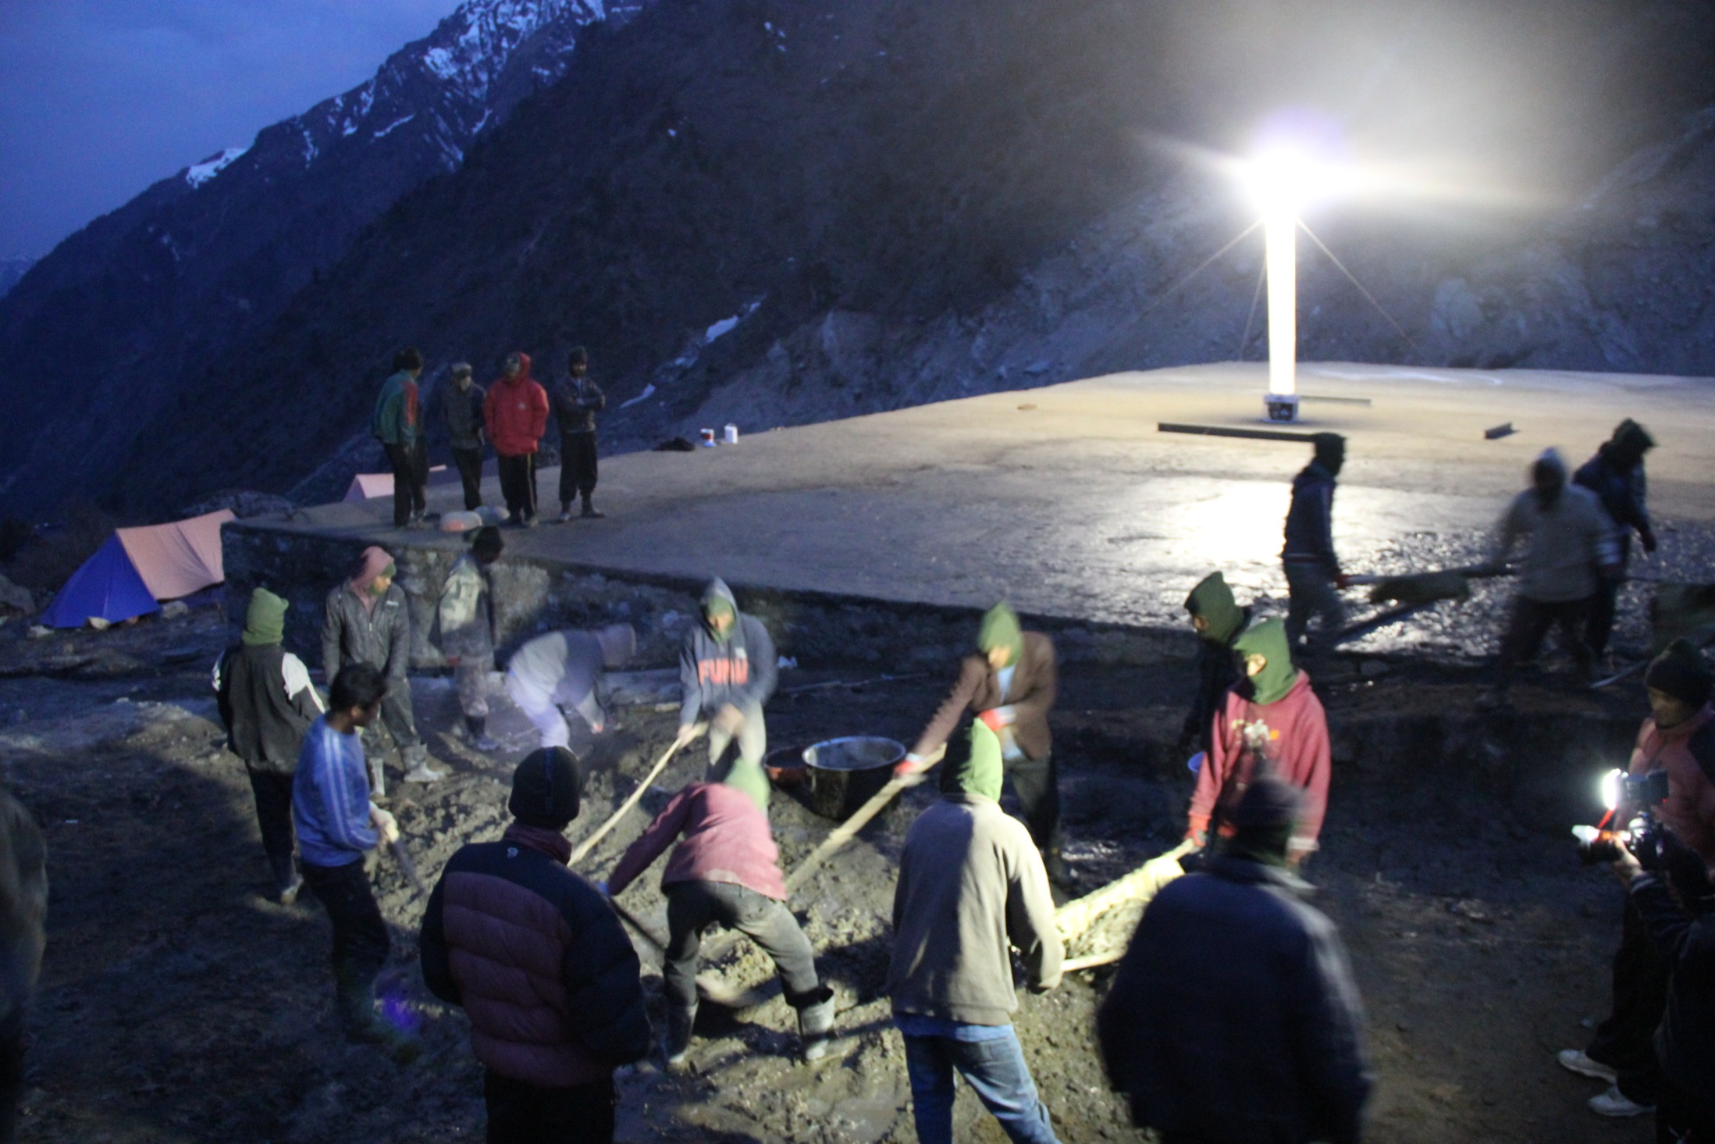
CONSTRUCTION OF HELIPAD AT LINCHOLI

Slide 27
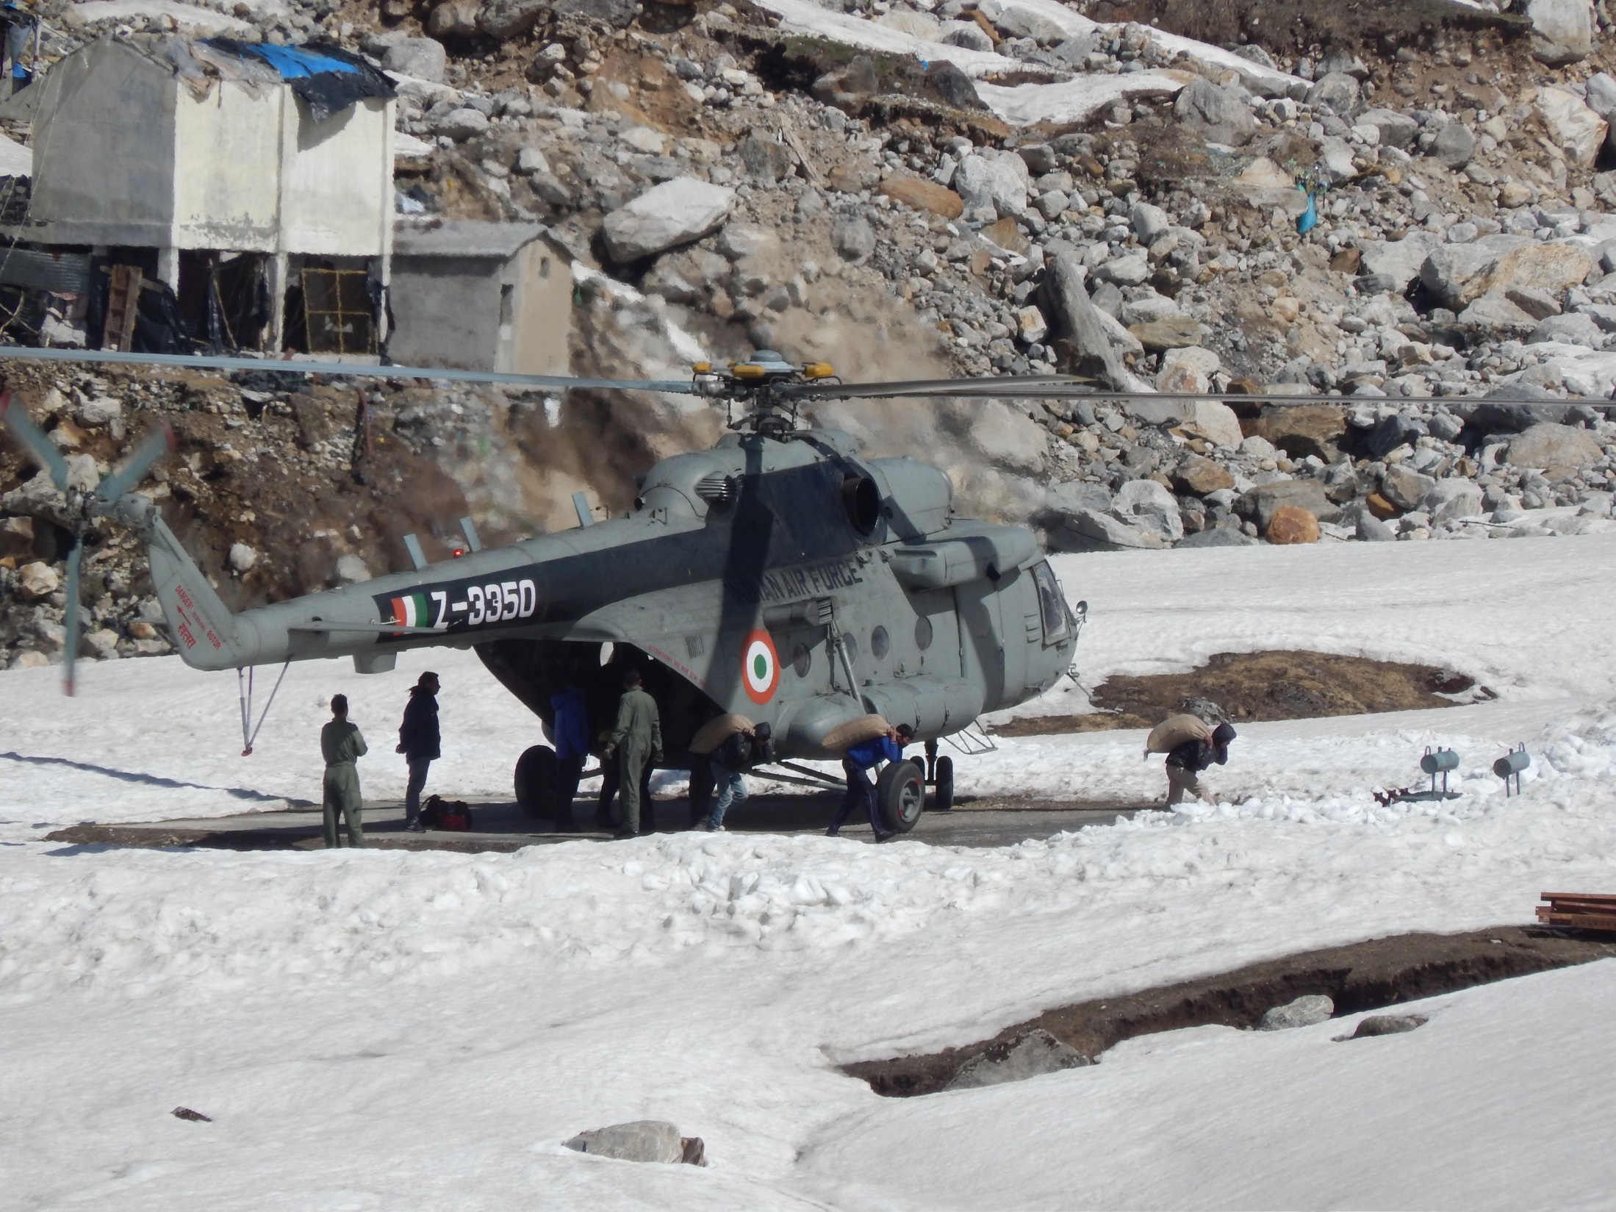
MI-17 IN KEDARNATH

Slide 28
Uttarkashi Disaster
18th August, 2019

Slide 29
Situation in Aarakot,
Uttarkashi
Heavy precipitation in and around Aarakot in the morning hours (around 0430 hrs)
Aarakot, Makudi, Tikochi-Nagwara, Snail, Duchanu and other neighbouring villages were severely affected
Around 10,000 people in 15 villages were completely cut-off from the mainland

Slide 30
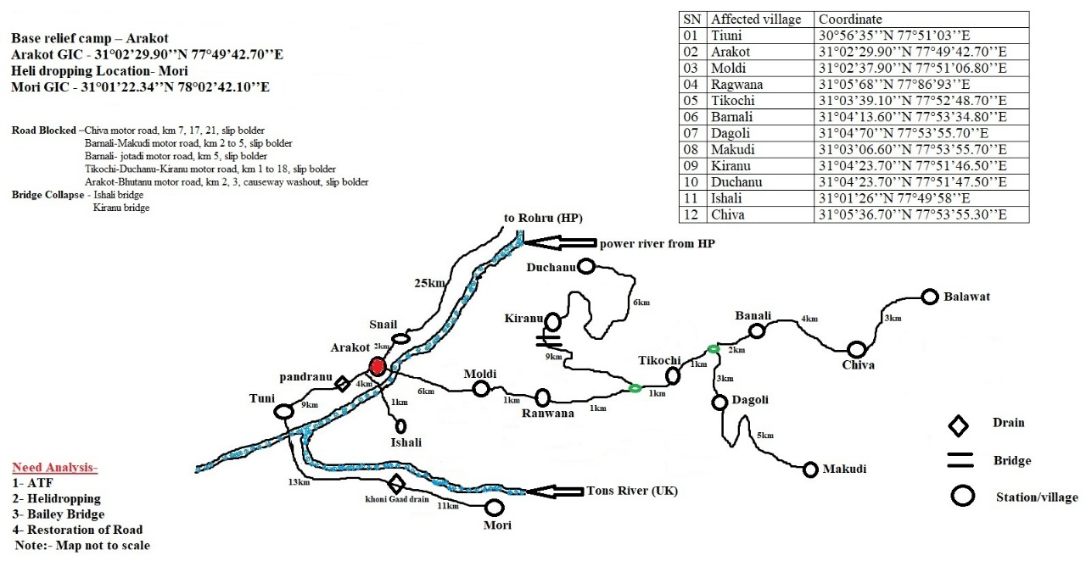

Slide 31
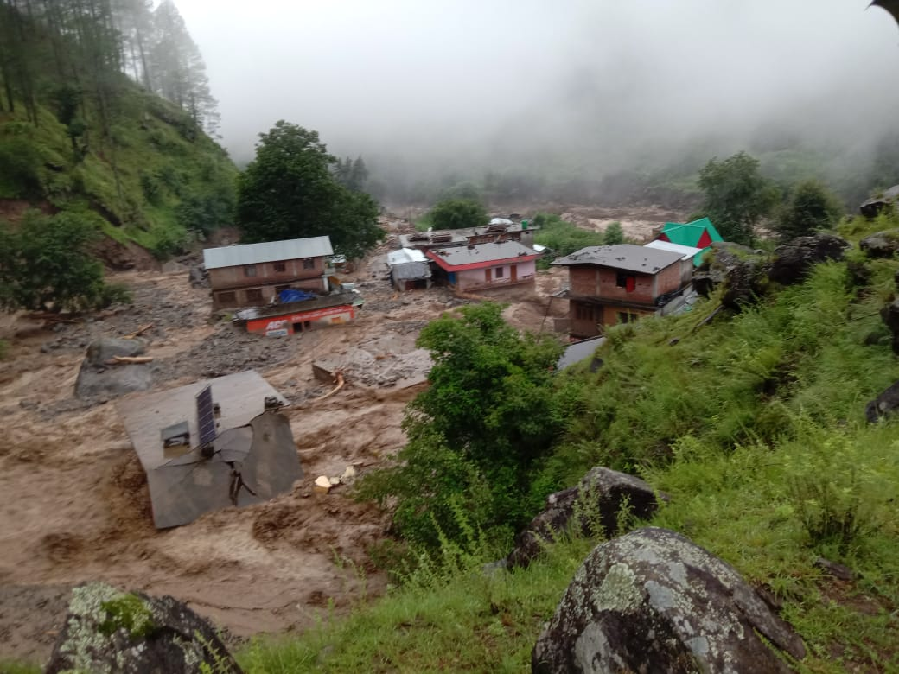
Aarakot, Uttarkashi

Slide 32
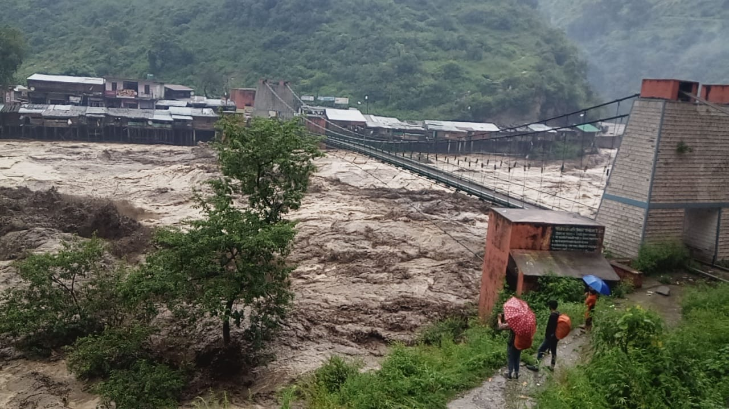
Flash Floods in Tyuni, Dehradun

Slide 33
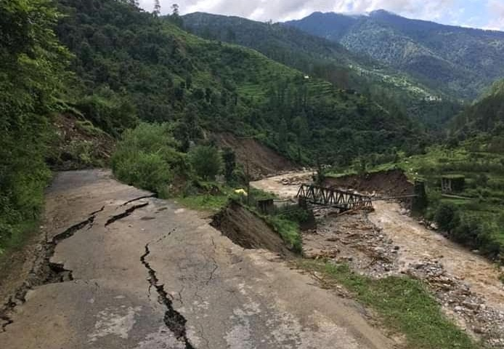
Road Connectivity disrupted

Slide 34
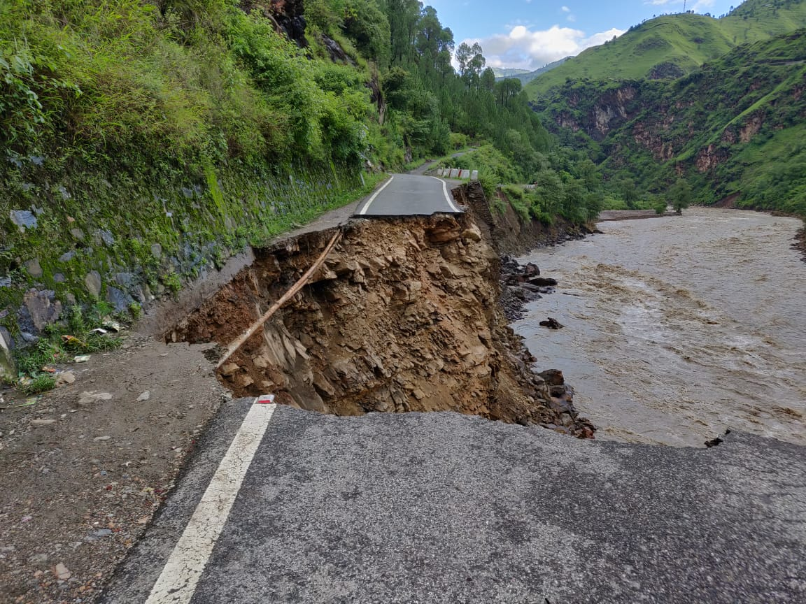
Aarakot, Uttarkashi

Slide 35
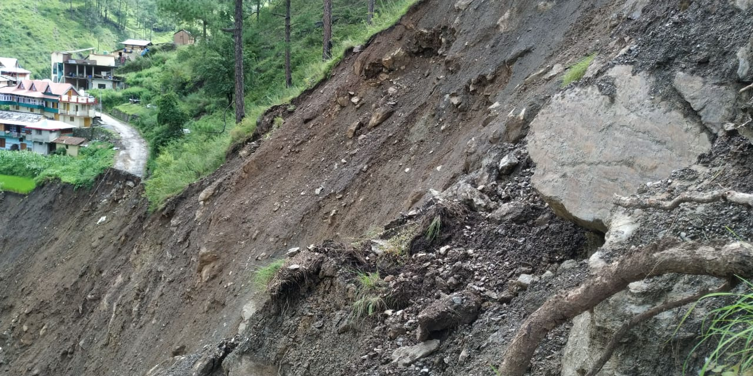
Road washed out in Aarakot, Uttarkashi

Slide 36
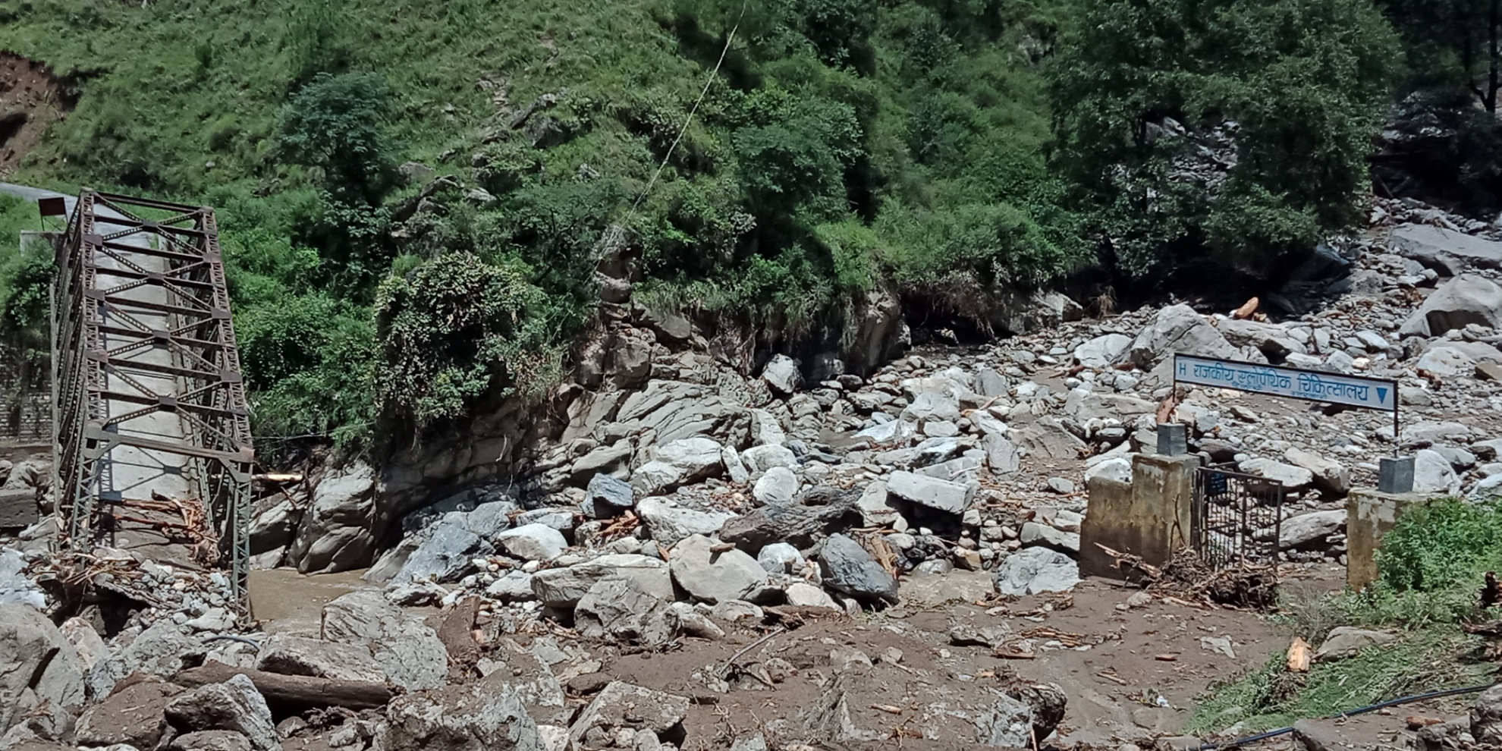
Motor Bridge collapsed at Tikochi, Uttarkashi

Slide 37
Search and Rescue Operations in Aarakot (Uttarkashi)

Slide 38
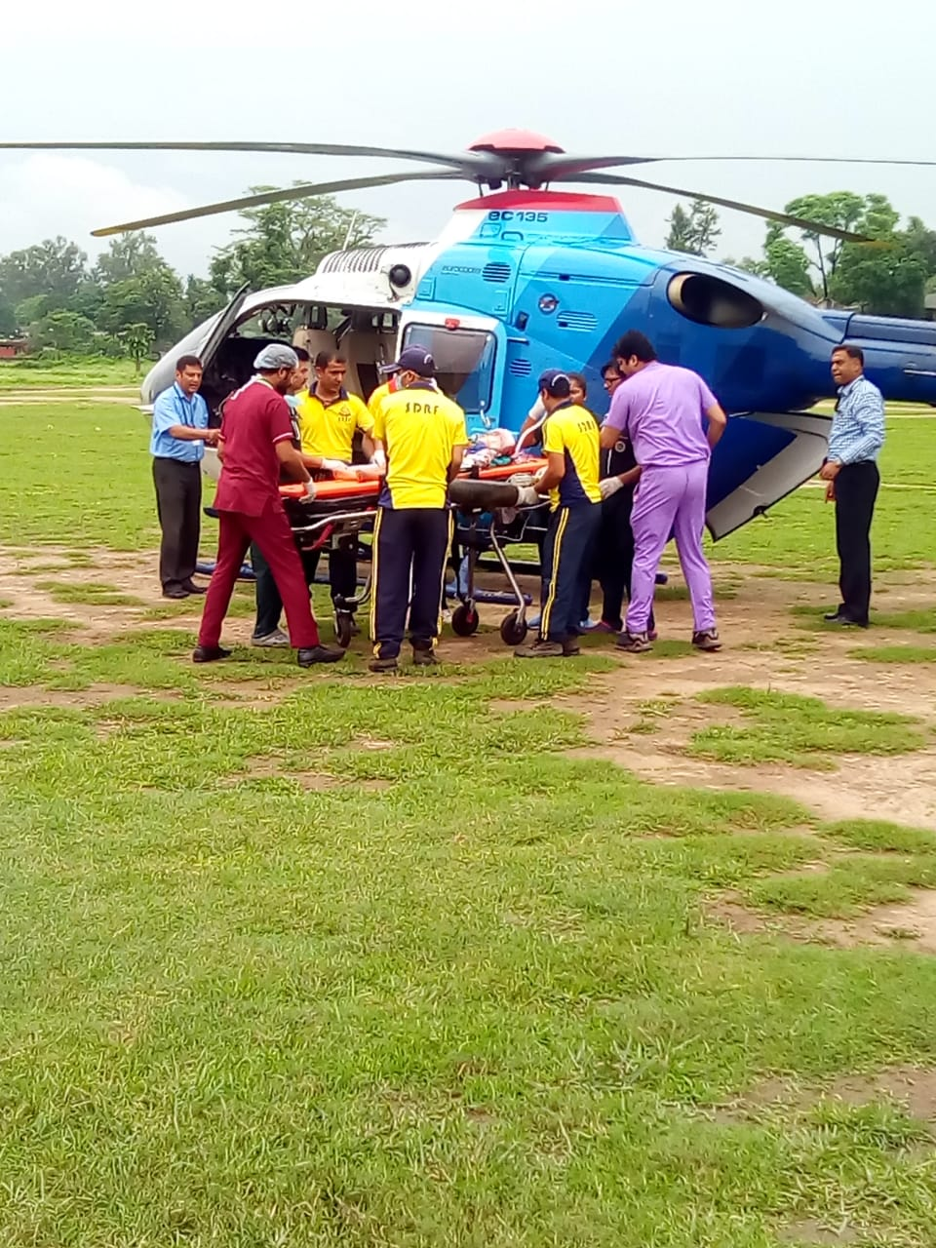
Heli- Operations in Aarakot

Slide 39
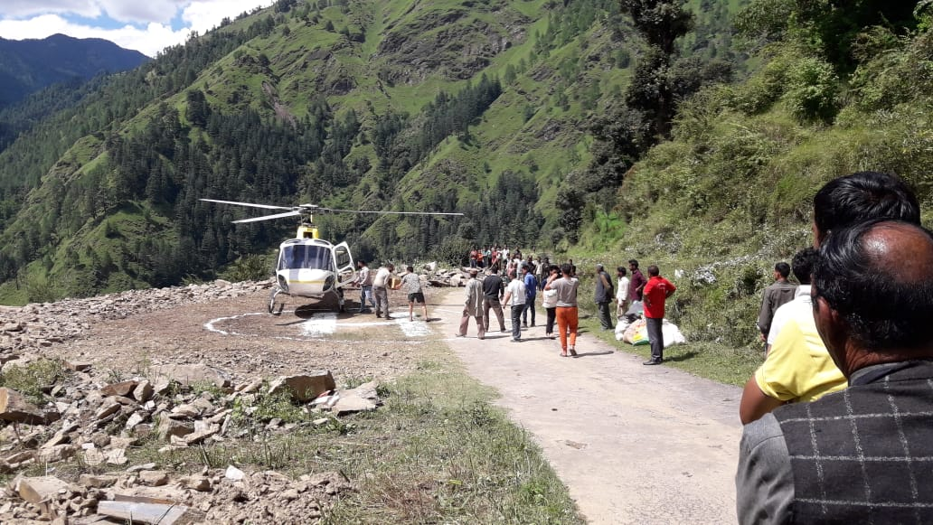
Temporary Helipad at Duchanu, Uttarkashi

Slide 40
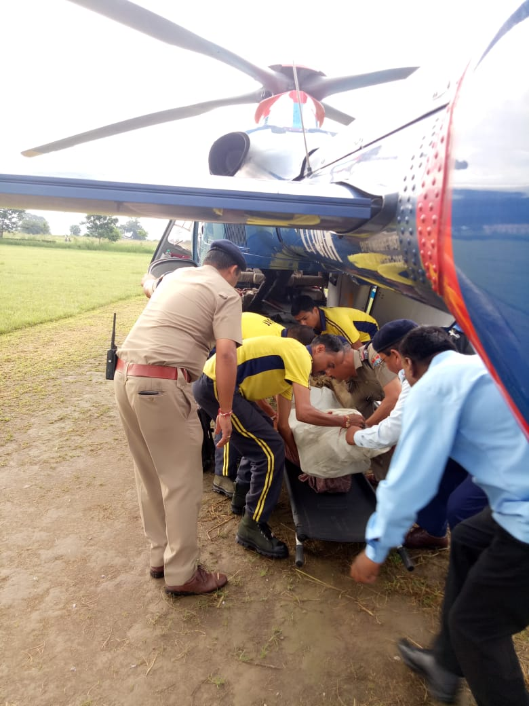
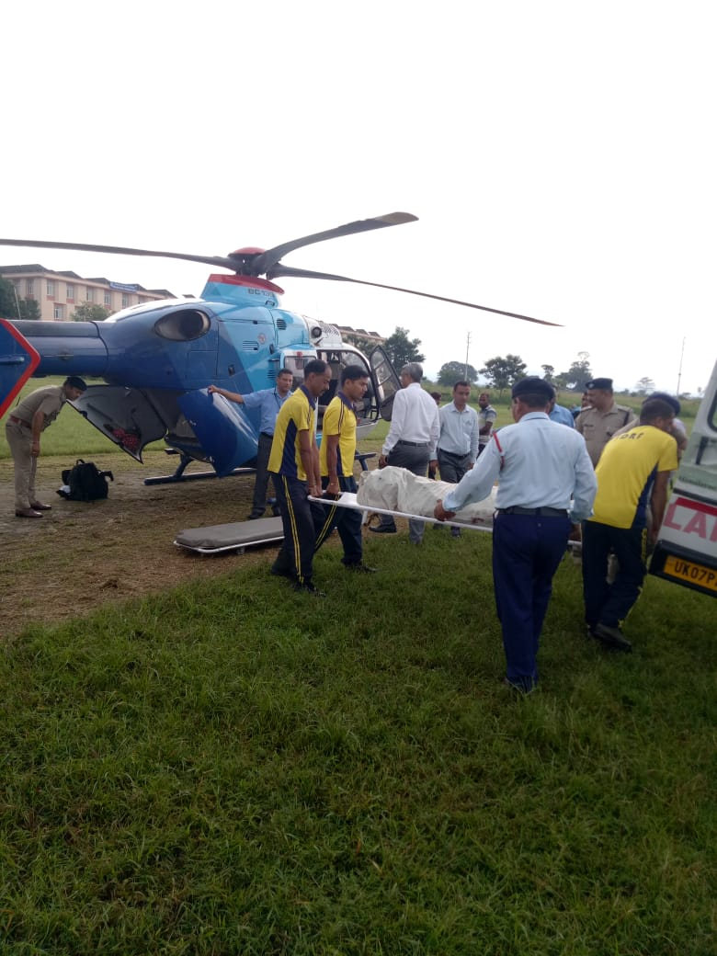
Heli- Operations from Aarakot to Dehradun

Slide 41
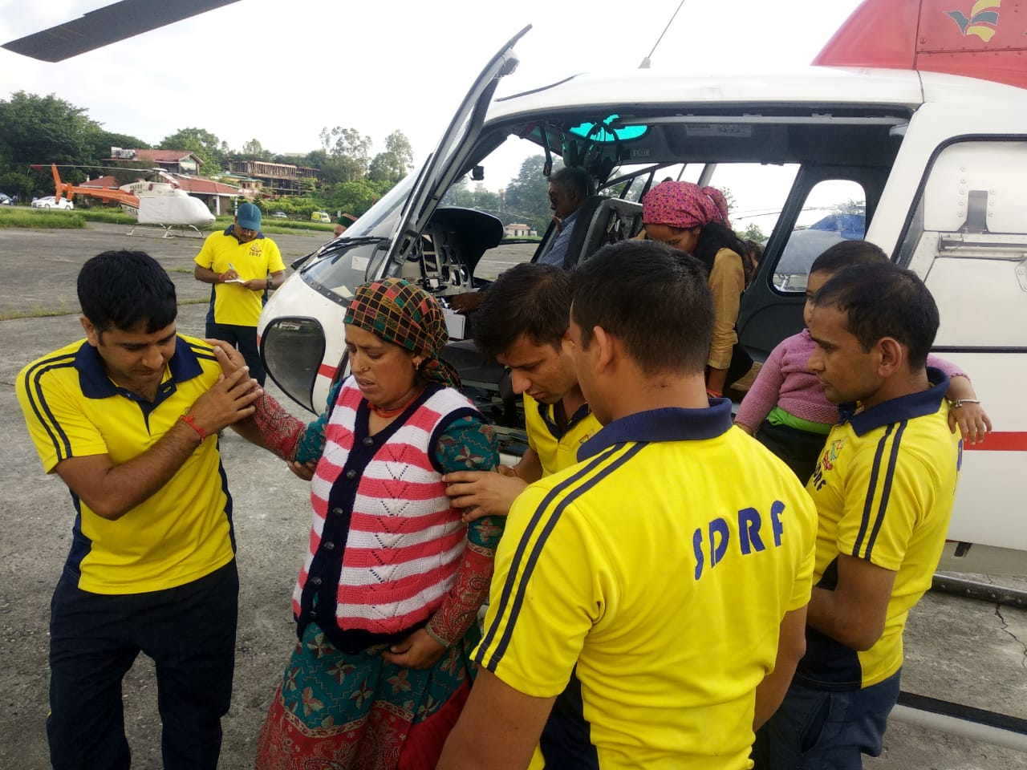
Rescue operations

Slide 42
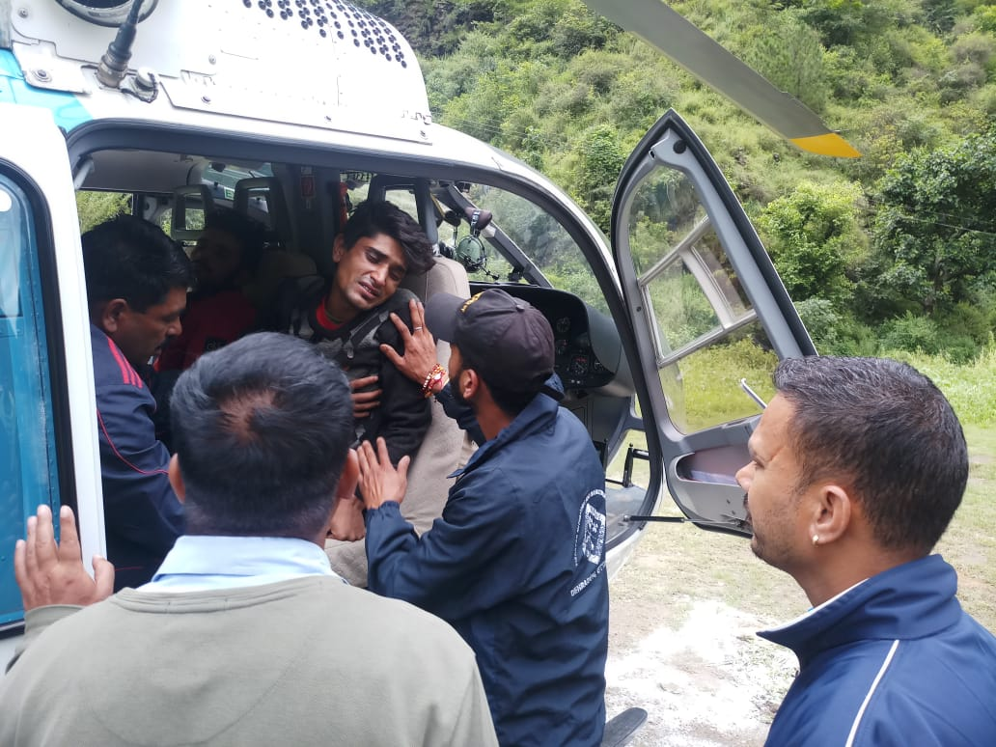
Rescue of injured people

Slide 43
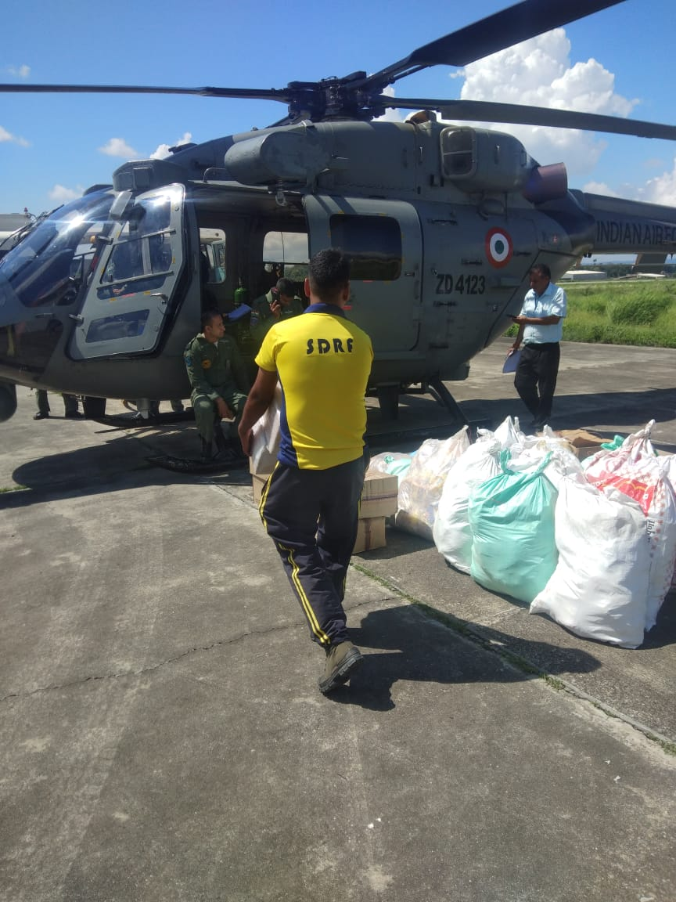
IAF chopper transporting relief material

Slide 44
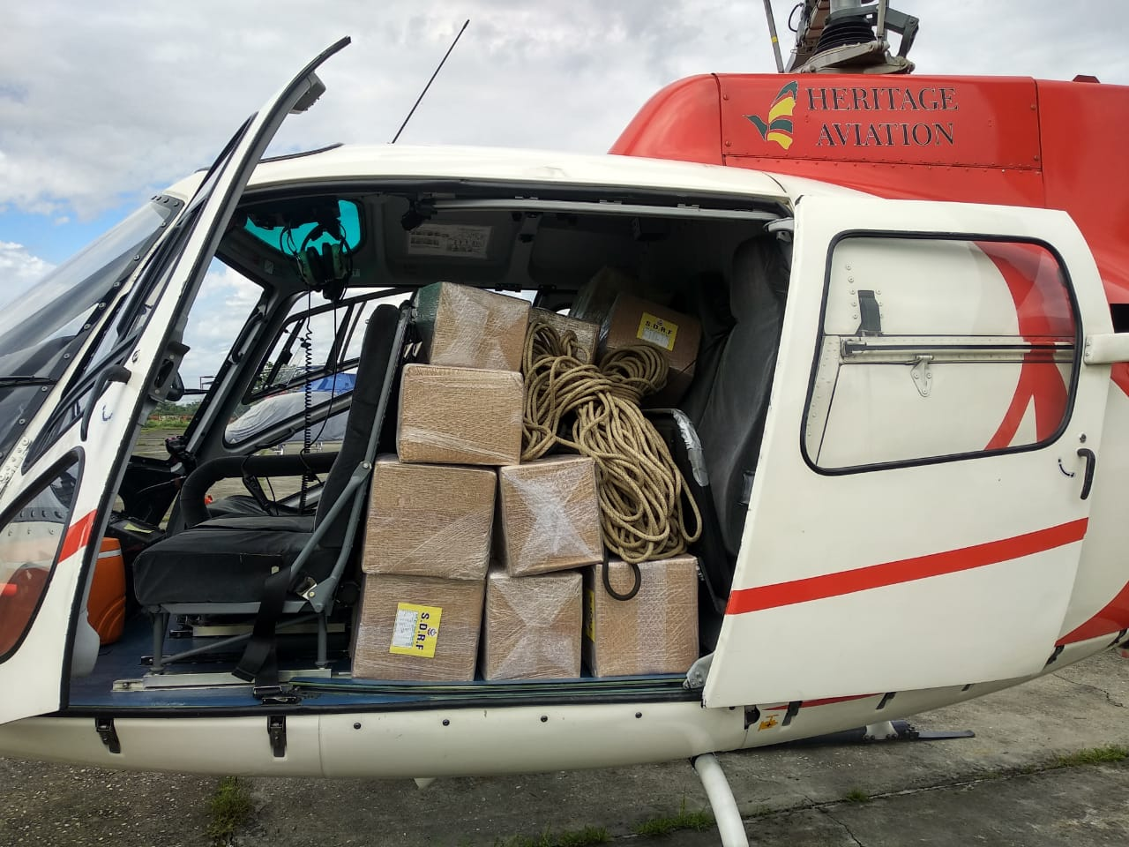
Relief material

Slide 45
Role of choppers in disaster relief
Fly-in experienced personnel to inaccessible locations
Fly-out injured and those requiring immediate medical attention
Rescue and evacuations
Transporting relief material (food, drinking water, tents, blankets, medical supplies, etc)
Ascertain the extent of the damage, thereby helping in post-disaster operations
Take aerial photographs for situation reports
Identify possible secondary dangers
Facilitate communication between the affected areas and the district authorities

Slide 46
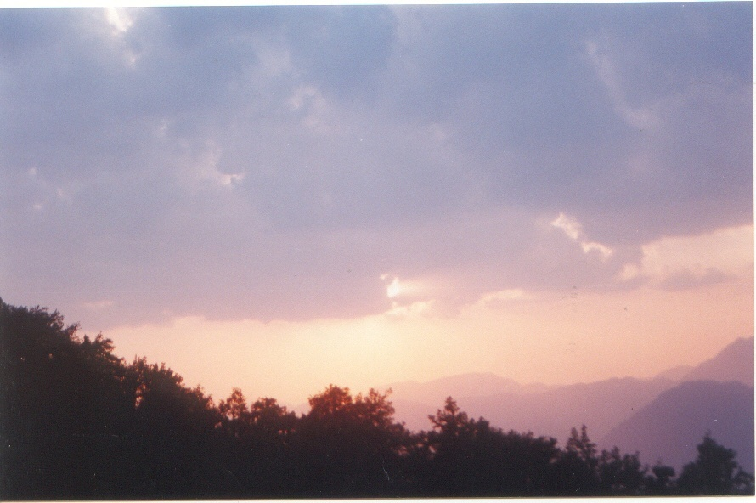
Thank you…

